Slide 1
APHG Chapter 1
By: Ms. Ramos

Slide 2
The Study of People and Places
Why do farmers in Kenya grow coffee and tea while many starve?
Globalization
Inequality
Arable land
Malnourished
The role of women and children
Poverty
Foreign Income

Slide 3
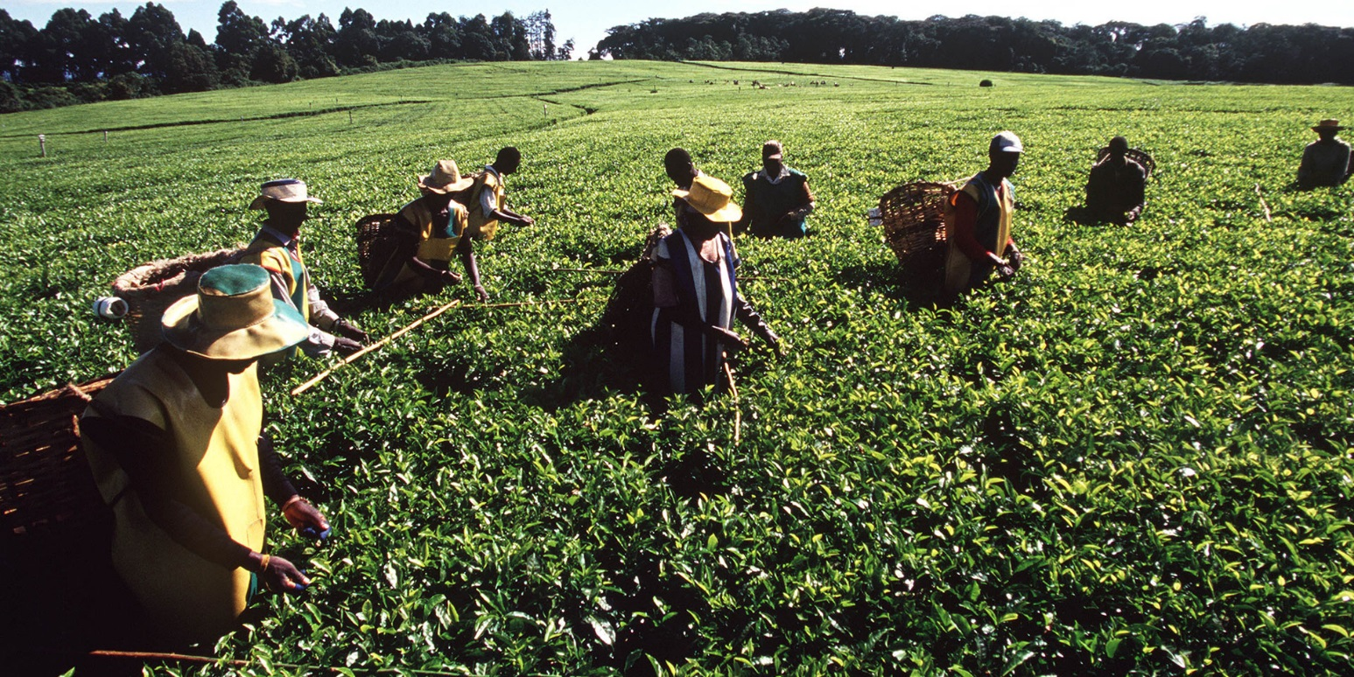
Kenya Coffee Farms

Slide 4
What is Human Geography?
The study of:
People and Places
How people make places
How we organized space and society
How we interact with each other and ourselves in our localities, regions, and the world.

Slide 5
Globalization
Definition
Thinking…..
Imagine and describe the most remote place on Earth you can think of 100 years ago. Now, describe how globalization has changed that place and how the people there continue to shape it and make it the place it is today.

Slide 6
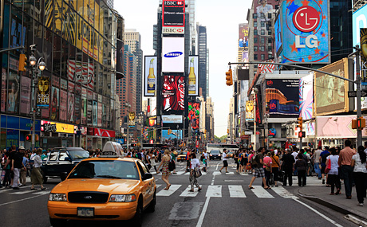
New York city times square picture

Slide 7
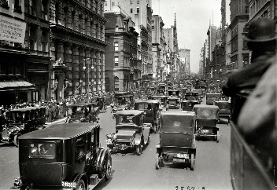
New York at the beginning the the 20th Century

Slide 8
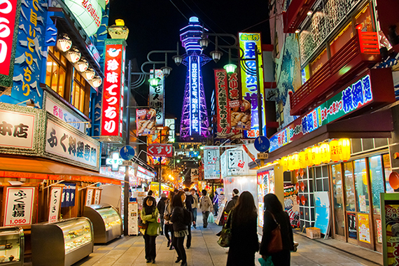
Globalization vs. Traditionalism

Slide 9
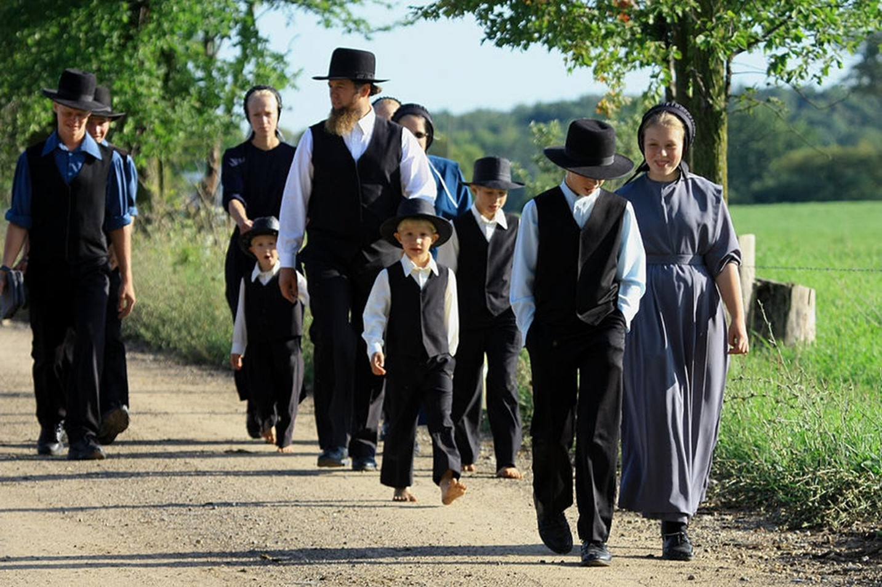
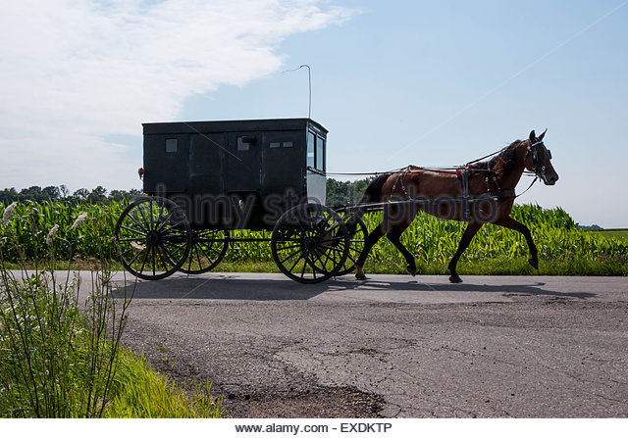
Globalization vs. Traditionalism

Slide 10
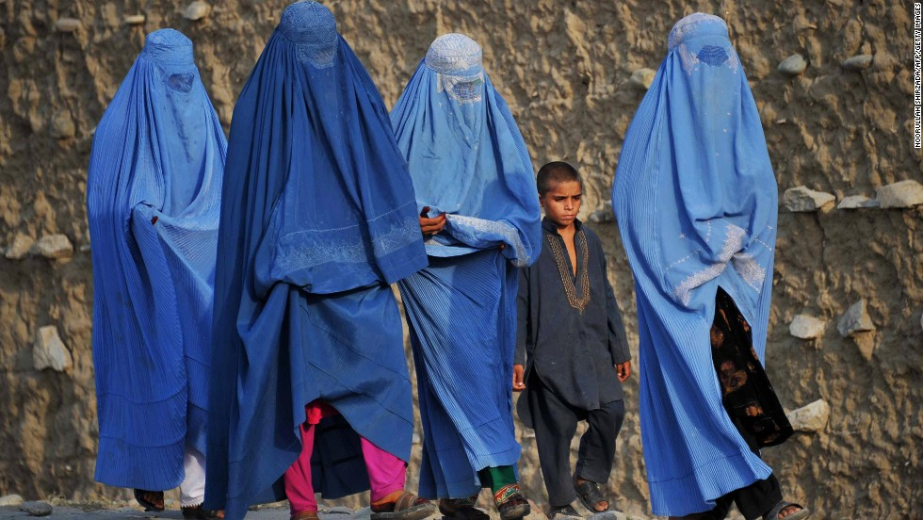

Slide 11
Spatial Distribution
Pandemic
Epidemic
Scale
Local
Regional
National
Global

Slide 12
Geographic Questions:
Geography study the physical and human Phenomena:
Human
Physical
Spatial Perspective… more than memorization

Slide 13
Cholera Case Study
Ms. Ramos Webpage
Nature and Perspective Page
https://www.theguardian.com/news/datablog/2013/mar/15/john-snow-cholera-map

Slide 14
5 themes of Geography
Ms. Ramos Webpage
Nature and Perspective

Slide 15
Cultural Landscape
Character of a place
Imprint of human activities on the landscape
Examples /photos

Slide 16
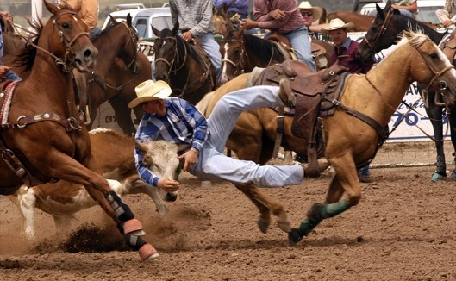
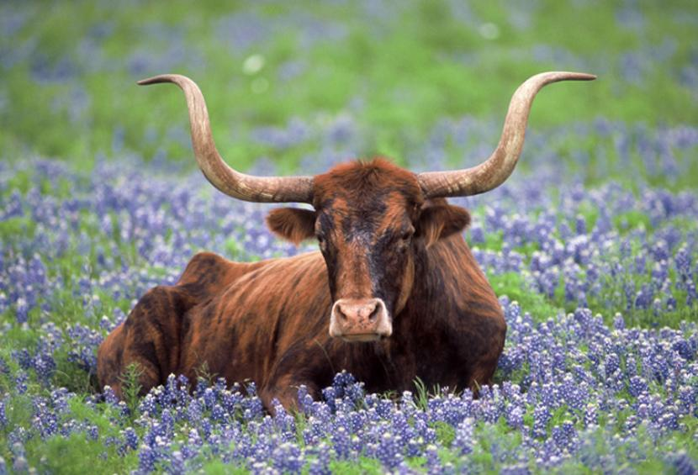
Where?

Slide 17
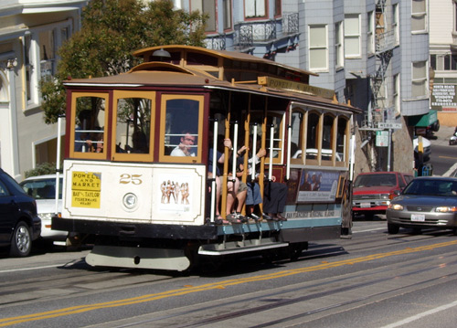
Where?

Slide 18
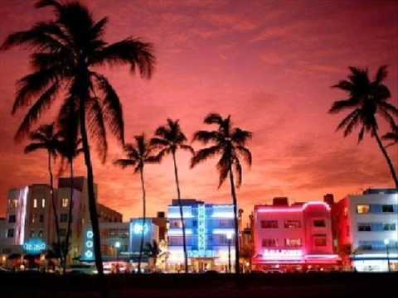
Where?

Slide 19
Cartography
Reference maps
Thematic maps
Mental maps
GIS and GPS

