Slide 1
Key Question
What imprint does agriculture make on the cultural landscape?

Slide 2
The Cadastral system

Slide 3
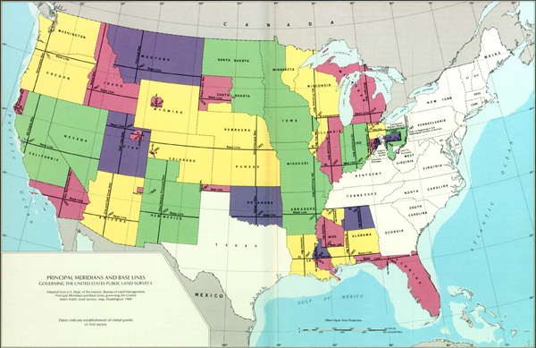
Cadastral System

Slide 4
Rectangular survey System

Slide 5
Township and range System

Slide 6
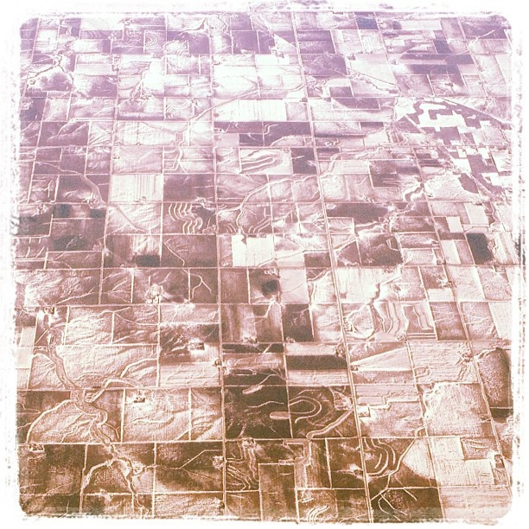
Midwest grid: ode to the public land survey system.

Slide 7
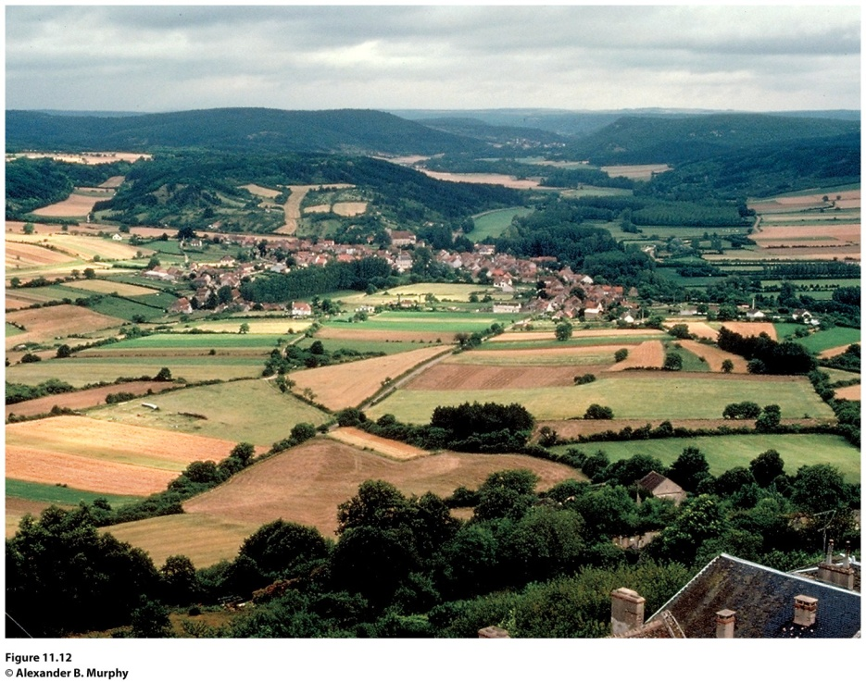
Villages
True farm villages, in which farming or providing services for farmers are the dominant activities, are disappearing.
Dispersed settlement pattern: individual farmhouses lie quite far apart and the land is intensively cultivated but by machine rather than by hand Ex: United States Midwest.
Nucleated settlement: the most prevalent rural residential pattern in agricultural areas
Figure 11.12
Acquitaine, France. The agricultural landscape of Aquitaine demonstrates three features of rural France: people living in nucleated villages, a highly fragmented land ownership pattern, and land divided according to the French long-lot system.
© Alexander B. Murphy.

Slide 8
Villages
Linear village: In many low-lying areas of Western Europe, villages are located on dikes and levees.
Cluster village may have begun as a small hamlet at the intersection of two roads and then developed by accretion.
Round village or rundling was first used by Slavic farmer-herdsmen in eastern Europe and was later modified by Germanic settlers.
Walled village: as a means of protection.
Grid village: more modern.

Slide 9
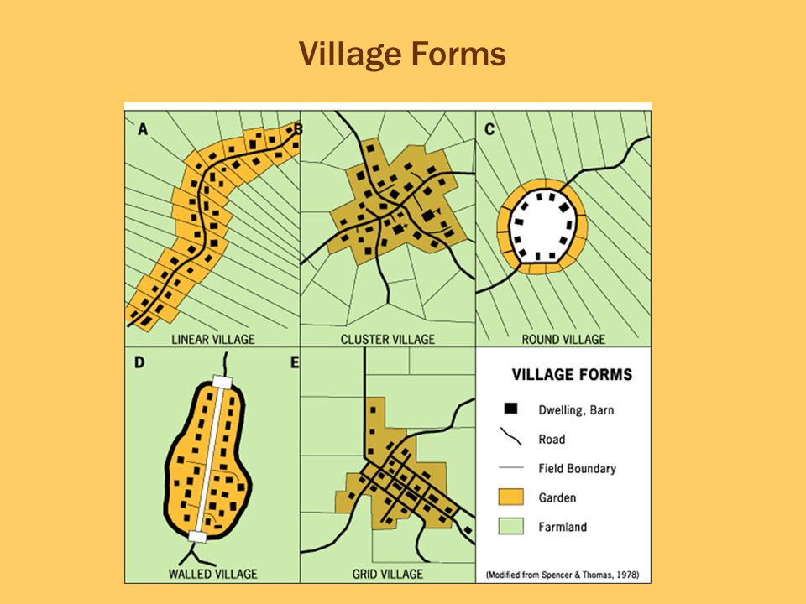

Slide 10
Functional Differentiation within Villages
Social stratification: reflected in the range in size and quality of houses, representing their owners’ wealth and standing in the community.
The functional differentiation of buildings within farm villages is more elaborate in some societies than in others.
Protection of livestock and storage of harvested crops are primary functions of farm villages.

