Slide 1
Chapter 9:
Urban Geography
Theories and Models
Notes:
Figure 9.2
Detroit, Michigan. The Lafayette Building once housed the offices of the Michigan Supreme Court. This photo from 2008 shows the boarded-up first and second floors and broken windows on the third floor. Urban explorers broke into and photographed abandoned buildings in Detroit (several websites are devoted to their photographs and videos), and vandals painted graffiti on the windows of Lafayette and other so-called ghosts of Detroit. © Erin H. Fouberg.

Slide 2
Site and Situation
The site of a city is its absolute location, often chosen for its advantages in trade or defense, or as a center for religious practice.
The situation of a city is based on its role in the larger, surrounding context:
  A city’s situation changes with times.
  Ex.: Rome becoming the center of the Roman Catholic Church.

Slide 3
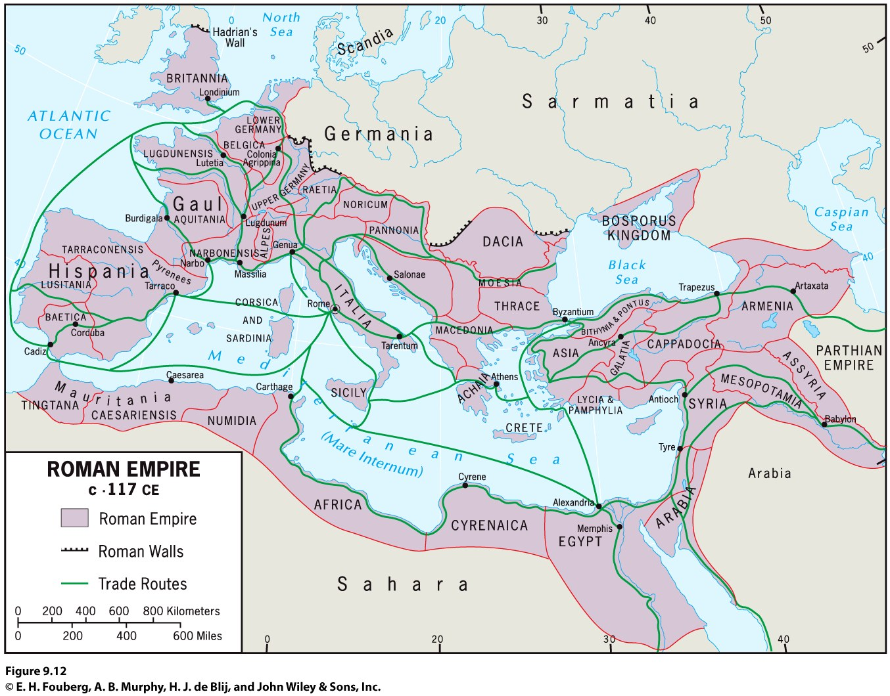

Slide 4
Site and Situation during European Exploration
The relative importance of the interior trade routes changed when European maritime exploration and overseas colonization ushered in an era of oceanic, worldwide trade.
The situation of cities like Paris and Xian (ancient capital of China) changed from being crucial in an interior trading route to being left out of an oceanic trade.
After European exploration took off during the 1400s, the dominance of interior cities declined.

Slide 5
Site and Situation during European Exploration
Coastal cities remained crucial after exploration led to colonialism.
The trade networks European powers commanded (including the slave trade) brought unprecedented riches to Europe’s flourishing medieval cities, such as Amsterdam (the Netherlands), London (England), Lisbon (Portugal), Liverpool (England), and Seville (Spain)

Slide 6
Rank and Size in the Urban Matrix
The rank-size rule holds that in a model urban hierarchy.
The rank-size rule does not apply in all countries, especially countries with one dominant city.
According to the rank-size rule, a rank 2 city would have ½ the population of a country’s largest city and a rank 3 city would have ⅓ the population of a country's largest city, a rank four city would have ¼ the population of the largest city, and so on.

Slide 7
Example:
Let's say that the largest city in Texas is Houston, and the second biggest is Dallas
Houston = 2.2 million people then....
Dallas = 1/2 of 2.2 million people (because they are the 2nd)

Slide 8
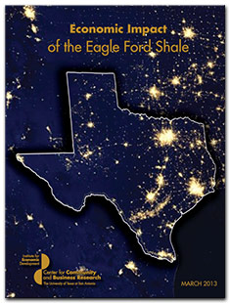

Slide 9
Primary City
Mark Jefferson: A primate city is “a country’s leading city, always disproportionately large and exceptionally expressive of national capacity and feeling.”
Primate cities exist in areas where the rank-size rule does not apply. Primate cities are cities that are disproportionately larger than all other cities in that region; these cities are normally the biggest contributor to the overall economy in that area or could possibly be one of few cities stimulating the economy.

Slide 10
Example:
As an "alpha" global city, Mexico City is one of the most important financial centers in North America.
We can see from the chart that Mexico City has a much greater number of people than the surrounding cities, making it a primate city; Mexico City is also Mexico's center of trade, economics, commerce, politics, culture and social areas. This makes sense because it houses the most people out of Mexico.

Slide 11
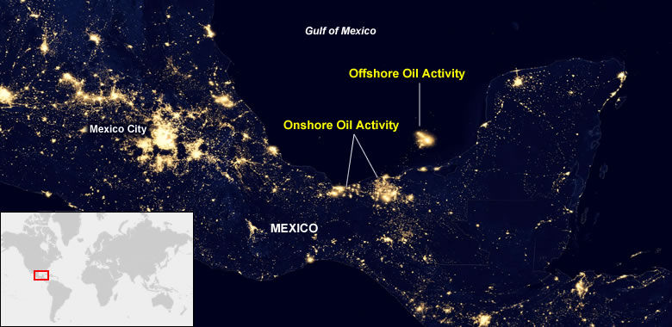

Slide 12
Central Place Theory
Central place theory: Walter Christaller, The Central Places in Southern Germany (1933), had five assumptions:
The surface of the ideal region would be flat and have no physical barriers.
Soil fertility would be the same everywhere
Population and purchasing power would be evenly distributed.
The region would have a uniform transportation network to permit direct travel from each settlement to the other.
From any given place, a good or service could be sold in all directions out to a certain distance.

Slide 13
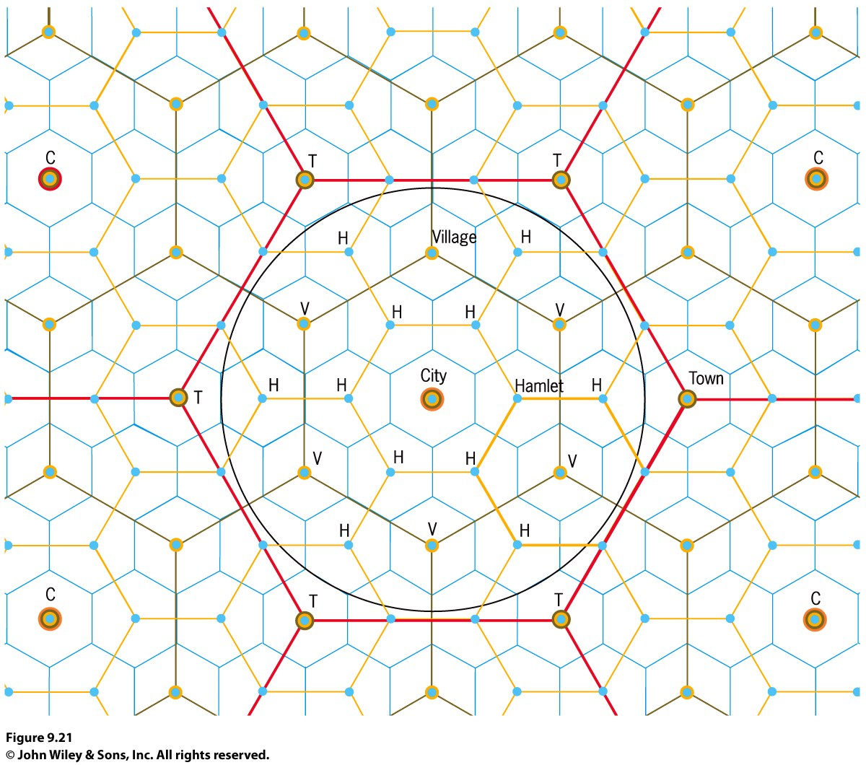
Central Place Theory
Each central place has a surrounding complementary region, an exclusive trade area within which the town has a monopoly on the sale of certain goods.
Hexagonal Hinterlands:
Christaller (Model designer)chose perfectly fitted hexagonal regions as the shape of each trade area.

Slide 14
Central Places Today
Where Are Cities Located, and Why?
New factors, forces, and conditions not anticipated by Christaller’s models and theories make them less relevant today.

Slide 15
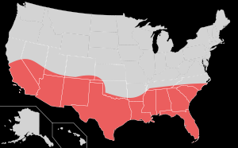
The Sun Belt phenomenon: the movement of millions of Americans from northern and northeastern states to the South and Southwest.
Sun Belt

Slide 16
How Are Cities Organized, and How Do They Function?
Models of the City
Functional zonation: the division of the city into certain regions (zones) for certain purposes (functions).
Globalization has created common cultural landscapes in the financial districts of many world cities.
Regional models of cities help us understand the processes that forged cities in the first place and understand the impact of modern linkages and influences now changing cities.

Slide 17
Functional Zones
Zone is typically preceded by a descriptor that conveys the purpose of that area of the city.
Most models define the key economic zone of the city as the central business district (CBD).
Central city describes the urban area that is not suburban. In effect, central city refers to the older city as opposed to the newer suburbs.
A suburb is an outlying, functionally uniform part of an urban area, and is often (but not always) adjacent to the central city.
Suburbanization is the process by which lands that were previously outside of the urban environment become urbanized, as people and businesses from the city move to these spaces.

Slide 18
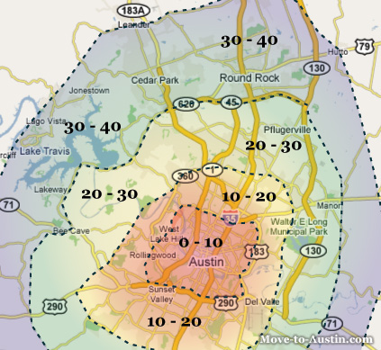

Slide 19
Functional Zones
P.O. Muller: Contemporary Suburban America (1981):
  Found suburban cities ready to compete with the central city for leading urban economic activities.
In addition to expanding residential zones, the process of suburbanization rapidly creates distinct urban regions complete with industrial, commercial, and educational components.

Slide 20
Modeling the North American City
Concentric zone model: resulted from sociologist Ernest Burgess’s study of Chicago in the 1920s. Burgess’s model divides the city into five concentric zones, defined by their function:
  CBD is itself subdivided into several subdistricts.
  Zone of transition is characterized by residential deterioration and encroachment by business and light manufacturing.
  Zone 3 is a ring of closely spaced but adequate homes occupied by the blue-collar labor force.
  Zone 4 consists of middle-class residences.
  Zone 5 is the suburban ring.

Slide 21
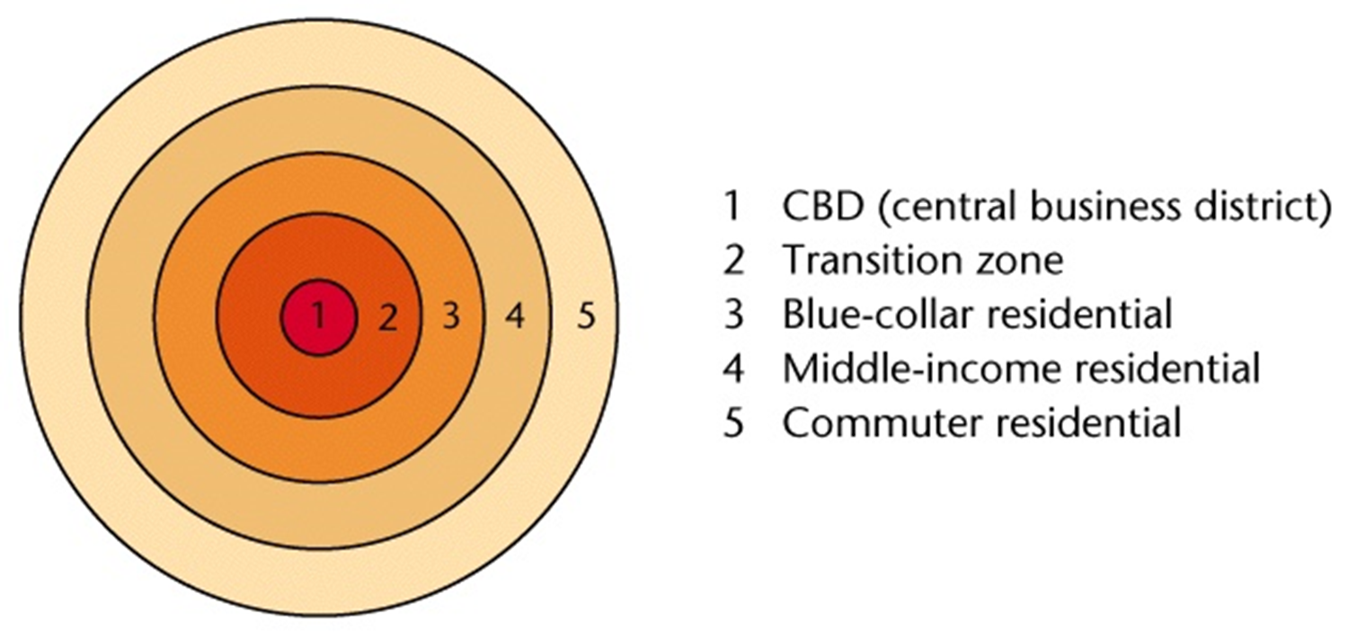

Slide 22
Modeling the North American City
Homer Hoyt: Sector model
The city grows outward from the center, so a low-rent area could extend all the way from the CBD to the city’s outer edge, creating zones that are shaped like a piece of pie.
The pie-shaped pieces describe the high-rent residential, intermediate rent residential, low-rent residential, education and recreation, transportation, and industrial sectors.

Slide 23
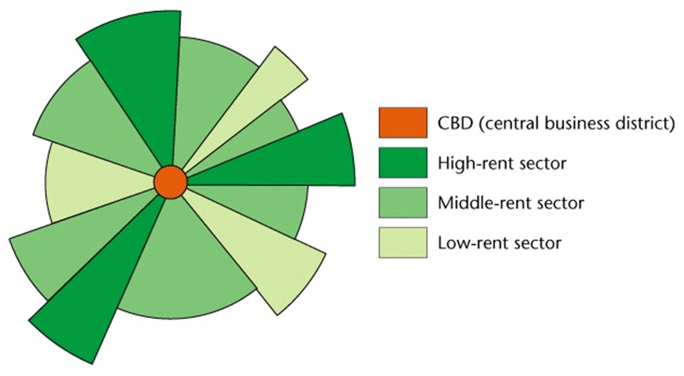

Slide 24
Multi-Nuclear Model
Suggested by Chauncey Harris and Edward Ullman in 1945
Maintained a city developed with equal intensity around various points
The CBD was not the sole generator of change

Slide 25
Multi-Nuclear Model
Equal weight must be given to:
An old community on city outskirts around which new suburbs clustered
An industrial district that grew from an original waterfront location
Low-income area that began because of some social stigma attached to site

Slide 26

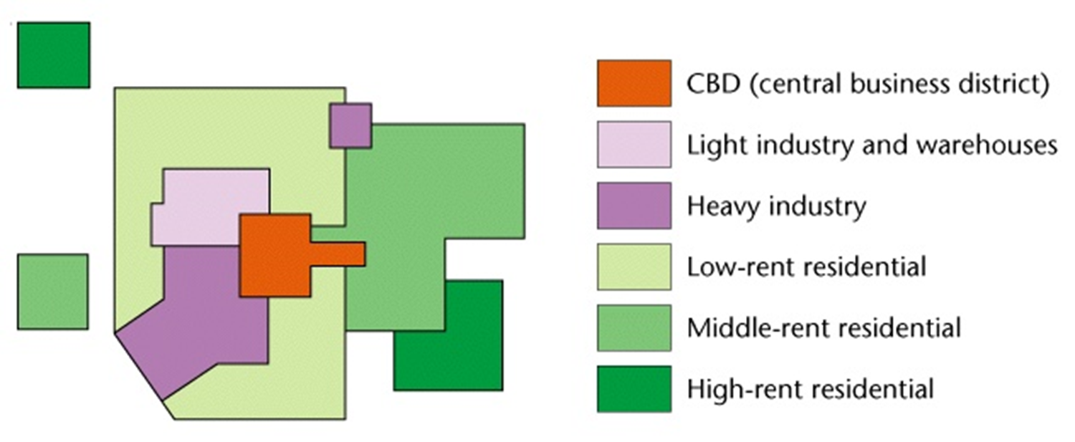

Slide 27
Modeling the North American City
Chauncy Harris and Edward Ullman: multiple nuclei model
This model recognizes that the CBD was losing its dominant position as the single nucleus of the urban area.
Edge cities: Suburban downtowns developed mainly around big regional shopping centers; they attracted industrial parks, office complexes, hotels, restaurants, enter-tainment facilities, and sports stadiums.

Slide 28
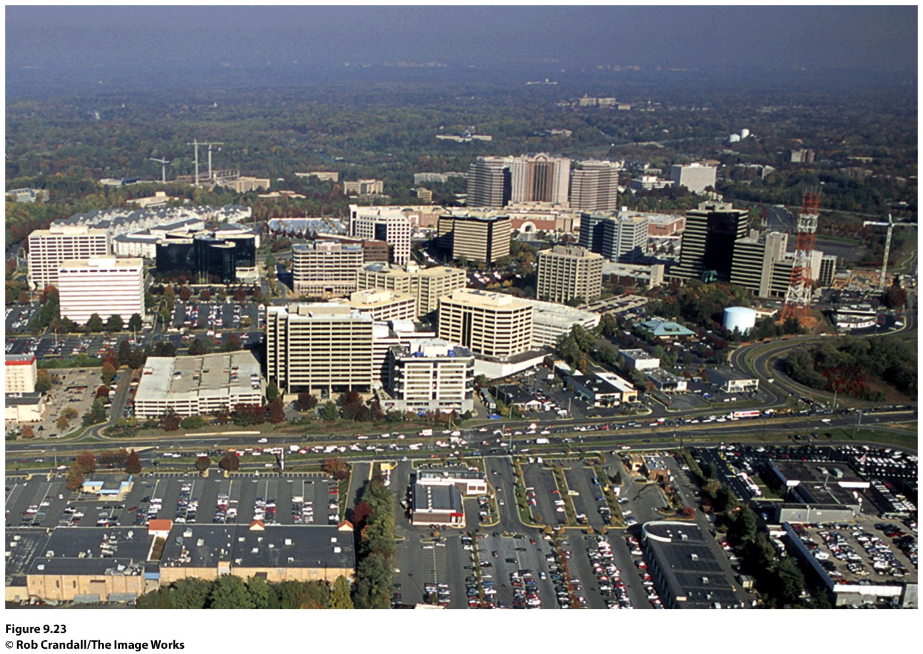
Figure 9.23
Tysons Corner, Virginia. In the suburbs of Washington, D.C., on Interstate 495 (the Beltway), Tysons Corner has developed as a major edge city, with offices, retail, and commercial services. © Rob Crandall/The Image Works.
Notes:
Figure 9.23
Tysons Corner, Virginia. In the suburbs of Washington, D.C., on Interstate 495 (the Beltway),
Tysons Corner has developed as a major edge city, with offi ces, retail, and commercial services. © Rob
Crandall/The Image Works.

Slide 29

Modeling the Cities of the Global Periphery and Semiperiphery
Primate cities in developing countries are called megacities when the city has a large population, a vast territorial extent, rapid in-migration, and a strained, inadequate infrastructure.
Concept Caching:
Mumbai, India
© Harm de Blij

Slide 30
The South American City
Griffin-Ford model
South American cities blend traditional elements of South American culture with globalization forces that are reshaping the urban scene, combining radial sectors and concentric zones.
The thriving CBD anchors the model.
Shantytowns are unplanned groups of crude dwellings and shelters made of scrap wood, iron, and pieces of cardboard that develop around cities.

Slide 31
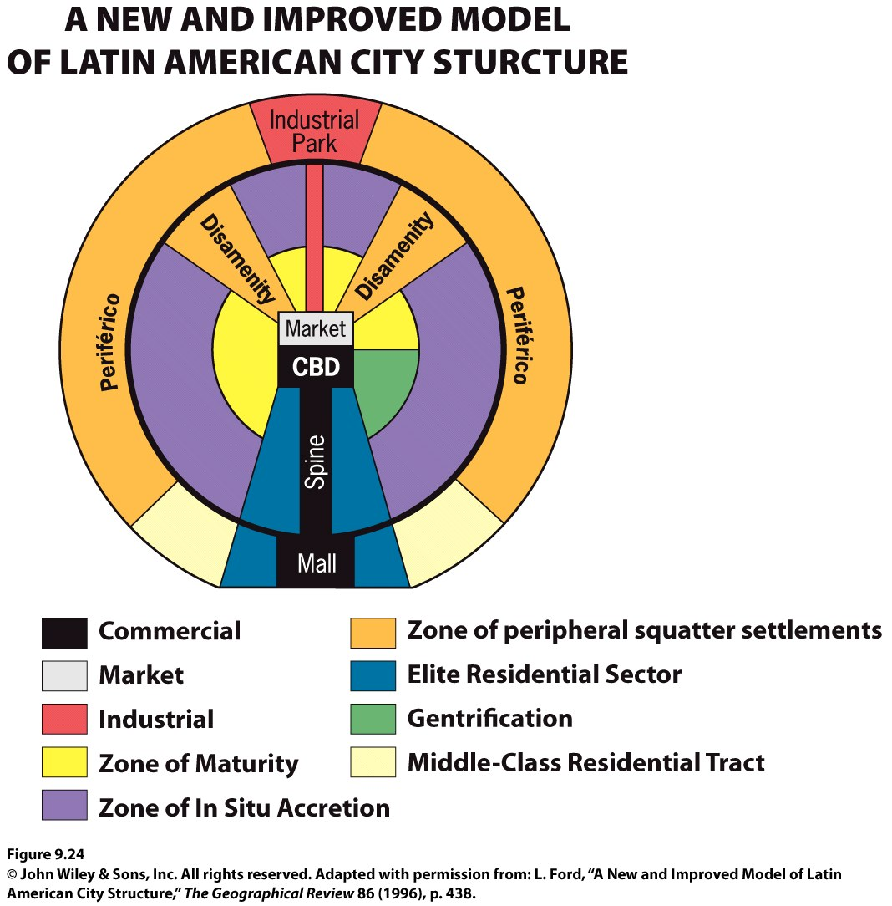

Slide 32
The African City
The imprint of European colonialism can still be seen in many African cities.
During colonialism, Europeans laid out prominent urban centers.
The centers of South Africa’s major cities (Johannesburg, Cape Town, and Durban) remain essentially Western.
Studies of African cities indicate that the central city often consists of not one but three CBDs: a remnant of the colonial CBD, an informal and sometimes periodic market zone, and a transitional business center where commerce is conducted.

Slide 33
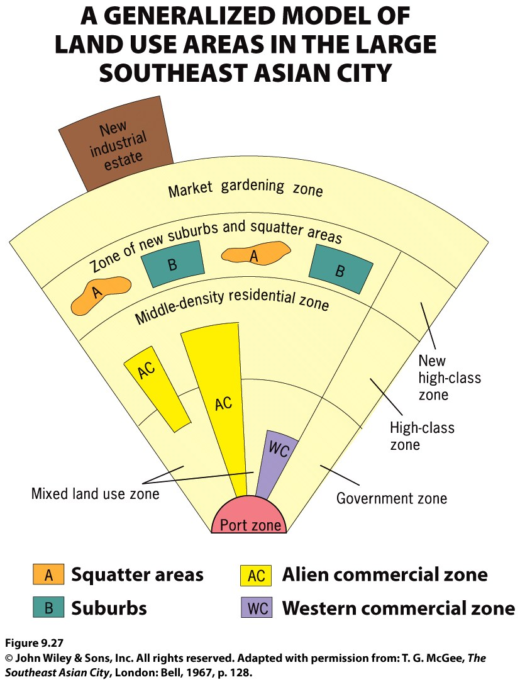
The Southeast Asian City
Figure 9.27
Model of the Large Southeast Asian City. A model of land use in the medium-sized Southeast Asian city includes sectors and zones within each sector. Adapted with permission from: T. G. McGee, The Southeast Asian City, London: Bell, 1967, p. 128.
Notes:
Figure 6.19
Llanfairpwllgwyngyllgogerychwyrndrobwllllantysiliogogogoch, Wales. The town with
the self-proclaimed longest name in the world attracts hordes of tourists each year to a place
whose claim to fame is largely its name. © Alexander B. Murphy.

Slide 34
Shaping Cities in the Global Periphery and Semiperiphery
How Do People Share Cities?
Particularly in the economic periphery, new arrivals (and long-term residents) crowd together in overpopulated apartments, dismal tenements, and teeming slums.
Cities in poorer parts of the world generally lack enforceable zoning laws.
Across the global periphery, the one trait all major cities display is the stark contrast between the wealthy and poor.

Slide 35
Shaping Cities in the Global Core
How Do People Share Cities?
During the segregation era in the United States, Realtors, financial lenders, and city governments defined and segregated spaces in urban environments.
Ex.: redlining, blockbusting
White flight—movement of whites from the city and adjacent neighborhoods to the outlying suburbs.

Slide 36
How Do People Share Cities?
In order to counter the suburbanization trend, city governments are encouraging commercialization of the central business district and gentrification of neighborhoods in and around the central business district.
Commercialization entails transforming the central business district into an area attractive to residents and tourists alike.
Gentrification is the rehabilitation of houses in older neighborhoods.
Teardowns: suburban homes meant for demolition; the intention is to replace them with McMansions.

Slide 37
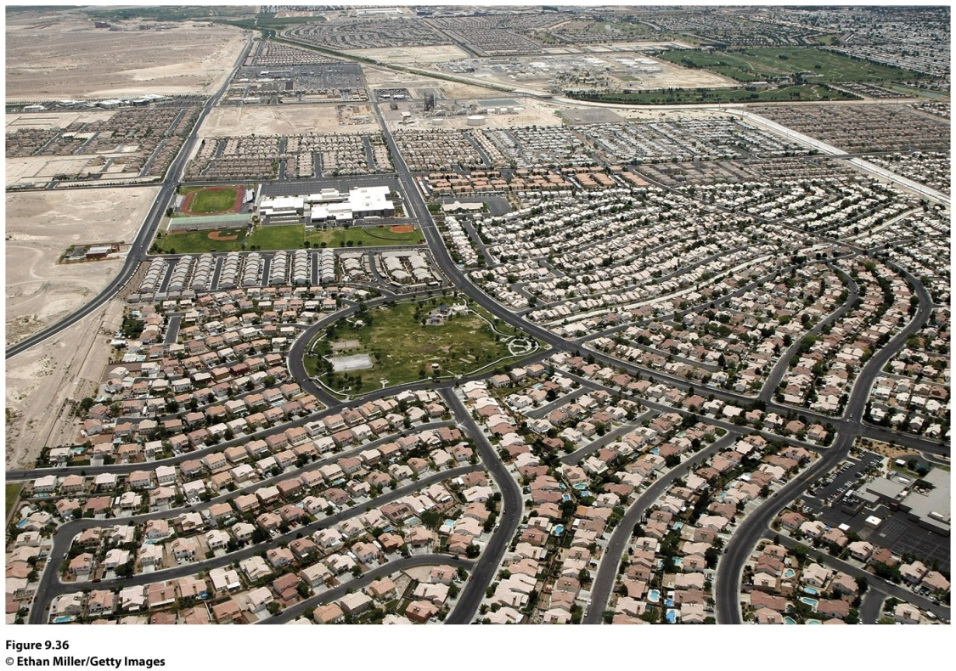
Urban Sprawl and New Urbanism
How Do People Share Cities?
Urban sprawl: unrestricted growth of housing, commercial developments, and roads over large expanses of land, with little concern for urban planning
Notes:
Figure 9.36
Henderson, Nevada. Henderson is the
largest suburb of Las Vegas, and it was also
the fastest-growing urban settlement in the
United States between 1990 and 2000. Many
of the houses in this photograph are empty
today, as Las Vegas has been fi rst or second
in the number of home and rental vacancies
in United States cities in 2009 and 2010.

Slide 38
Urban Sprawl and New Urbanism
To counter urban sprawl, a group of architects, urban planners, and developer outlined an urban design vision they call new urbanism: development, urban revitalization, and suburban reforms that create walkable neighborhoods with a diversity of housing and jobs
Geographer David Harvey argues the new urbanism movement is a kind of “spatial determinism” that does not recognize that “the fundamental difficulty with modernism was its persistent habit of privileging spatial forms over social processes.”
Other critics say “communities” that new urbanists form through their projects are exclusionary and deepen the racial segregation of cities.

Slide 39
Galactic City
https://prezi.com/rsf9yximdpdv/galactic-city-model/

Slide 40
Urban Decay
Detroit’s Decline
https://www.youtube.com/watch?v=pDoUpXNmcZA

Slide 41
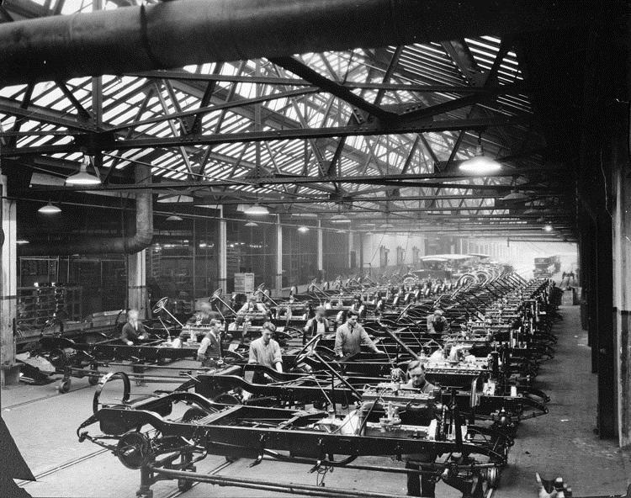
Past

Slide 42
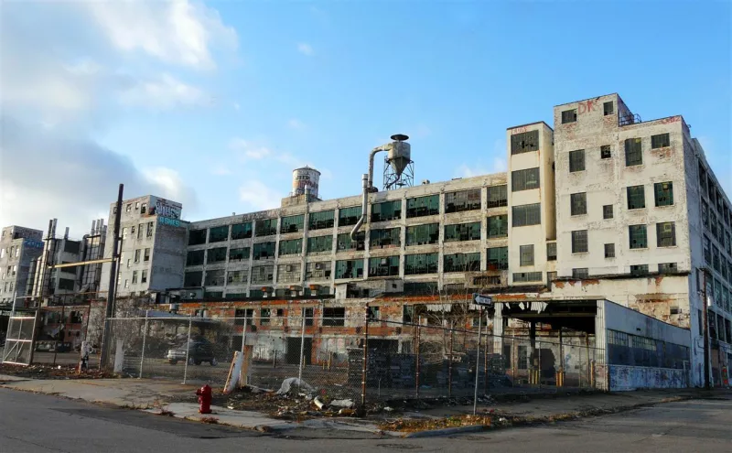
Present

Slide 43
The Geography of Detroit’s Decline
During the mid-20th century, Detroit was the fourth largest city in the United States with a population of over 1.85 million people. It was a thriving metropolis that embodied the American Dream - a land of opportunity and growth.

Slide 44
Today, Detroit has become a symbol of urban decay. Detroit's infrastructure is crumbling and the city is operating at $300 million dollars short of municipal sustainability. It is now the crime capital of America, with 7 out of 10 crimes unsolved. More than a million people have left the city since its prominent fifties. There are a multitude of reasons as to why Detroit's fell apart, but all the fundamental causes are rooted in geography

Slide 45

"keno capitalism" (Dear and Flusty 1998). In this model, based on Los Angeles, different districts are laid out in an essentially random grid, similar to a the board used in the gambling game keno. The premise of this model is that the internet and modern transportation systems have made location and distance largely irrelevant (not important) to the location of different sorts of activities within a city.

Slide 46
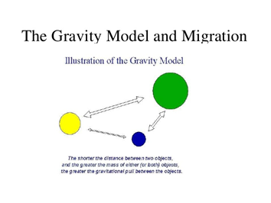
The Gravity Model is a model used to estimate the amount of interaction between two cities. It is based on Newton's universal law of gravitation, which measured the attraction of two objects based off their mass and distance.

Slide 47
This model study the relative strength of
A bond between 2 places. The model was created to
predict movement of people, information, and commodities
between cities and even continents.
This model takes into account the:
Population
2 Places
Distance
To determinate the gravity multiply the population of a city A
By the population of city B and then divide the product by the
distance between the 2 cities squared.
Population 1 x Population 2
_______________________ = gravity or attraction
Distance between the 2

Slide 48
Gravity Model Exercise:
Which two cities have bigger gravity or attraction?
Population:
New York City- 8,406,000
Austin- 885,400
Albuquerque- 556,495
Distance:
NY to Aus- 1,742.2 mi
Albu to Aus-694.6 mi

