Slide 1
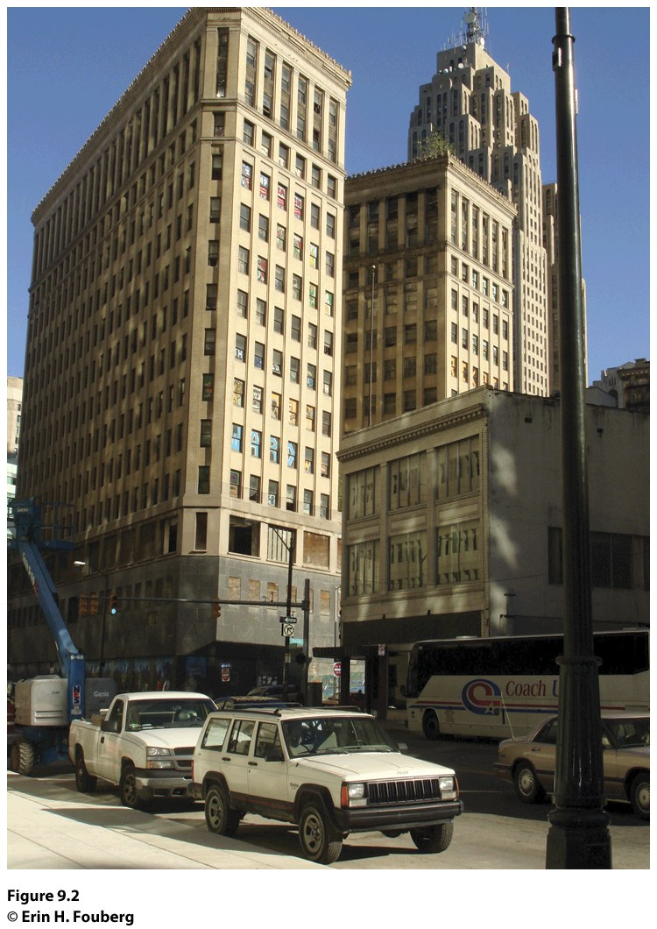
Chapter 9: Urban Geography
Notes:
Figure 9.2
Detroit, Michigan. The Lafayette Building once housed the offices of the Michigan Supreme Court. This photo from 2008 shows the boarded-up first and second floors and broken windows on the third floor. Urban explorers broke into and photographed abandoned buildings in Detroit (several websites are devoted to their photographs and videos), and vandals painted graffiti on the windows of Lafayette and other so-called ghosts of Detroit. © Erin H. Fouberg.

Slide 2
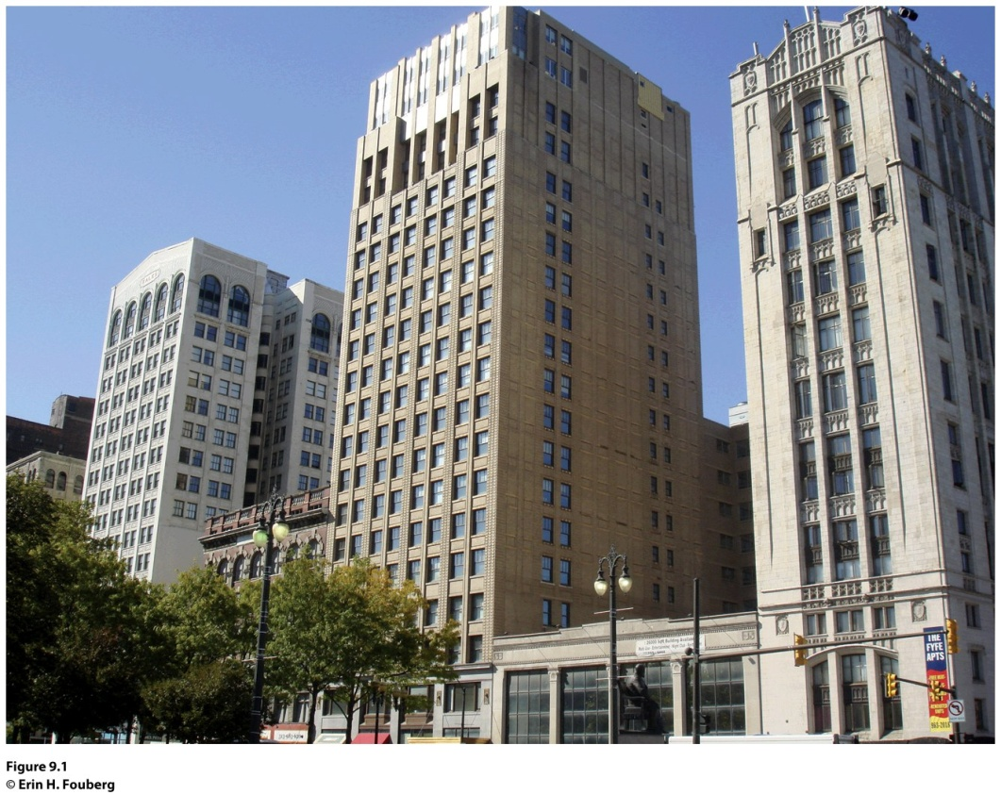
Field Note: Ghosts of Detroit?
“The semicircular shaped Grand Circus Park in Detroit, Michigan is divided by several streets, making it look like the hub and spokes of a bicycle wheel from above. The grouping of buildings along Grand Circus Park (Fig 9.1) reflects the rise, fall, and revitalization of the central business district (CBD) in Detroit. The central business district is a concentration of business and commerce in the city’s downtown…Abandoned high-rise buildings called the ghosts
of Detroit are joined by empty single-family homes to account for 10,000 abandoned buildings in the city.”
Notes:
*Could be an audio file.
Figure 9.1
Detroit, Michigan. The buildings along West Adams Street face Grand Park Circus in
Detroit, Michigan. From left to right, the Kales Building, Adams Theater, Grand Park Centre,
and Fyfe Apartments have experienced the rise, decline, and revitalization of the neighborhood,
which is located in the Central Business District. © Erin H. Fouberg.
Figure 6.1
Brussels, Belgium. A health insurance offi ce in the bilingual capital city of Brussels displays
duplicates of each of their posters, one in French and one in Flemish. © Erin H. Fouberg.

Slide 3
Key Question
When and why did people start living in cities?

Slide 4
When and Why Did People Start Living in Cities?
Urban: the built-up space of the central city and suburbs
Includes the city and surrounding environs connected to the city
Is distinctively nonrural and nonagricultural

Slide 5
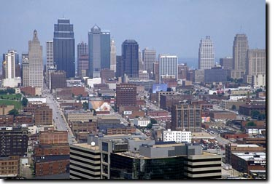
A city is an agglomeration of people and buildings clustered together to serve as a center of politics, culture, and economics.
Concept caching:
Kansas City, MO
© Barbara Weightman

Slide 6
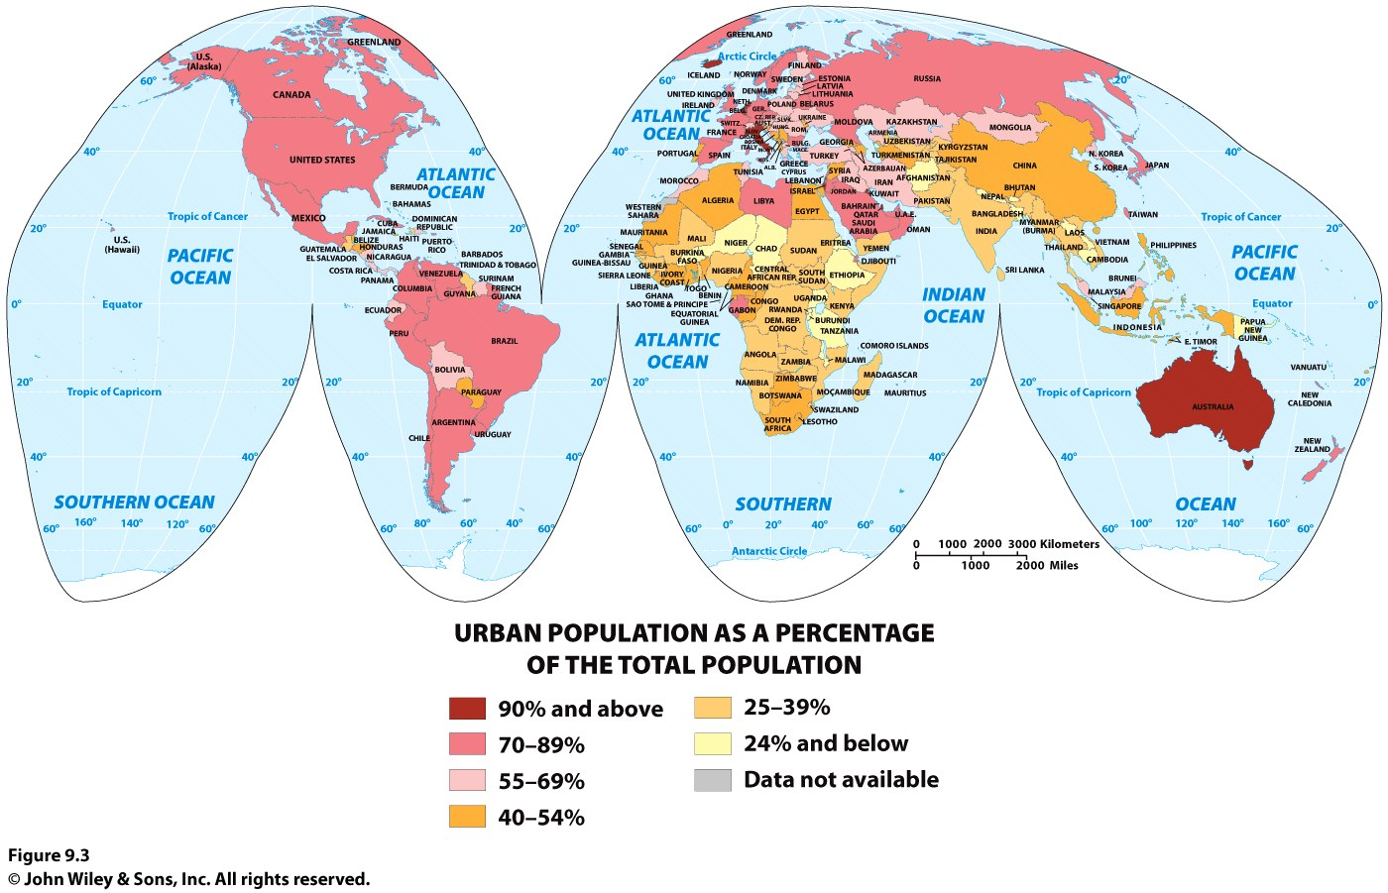

Slide 7
When and Why Did People Start Living in Cities?
The Hearths of Urbanization
The first agricultural hearth was the area of Southwest Asia called the Fertile Crescent.
Agricultural surplus and social stratification enabled cities to stabilize and grow.
The leadership class, or urban elite, consisted of a group of decision makers and organizers who controlled the resources.

Slide 8
When and Why Did People Start Living in Cities?
The Hearths of Urbanization
The innovation of the city is called the first urban revolution, and it occurred independently in six separate hearths, a case of independent invention.
The six urban hearths are tied closely to agriculture.

Slide 9
When and Why Did People Start Living in Cities?
The Hearths of Urbanization
The Six Hearths of Urbanization
Mesopotamia, 3500 B.C.E.
Nile River Valley, 3200 B.C.E.
Indus River Valley, 2200 B.C.E.
Huang He Valley, 1500 B.C.E.
Mesoamerica, 1100 B.C.E.
Peru, 900 B.C.E.

Slide 10
When and Why Did People Start Living in Cities?
The Role of the Ancient City in Society
Served as economic nodes
Were the chief marketplaces
Were the anchors of culture and society, the focal points of power, authority, and change

Slide 11
When and Why Did People Start Living in Cities?
Populations in Mesopotamia grew with the steady food supply and a sedentary lifestyle
People migrated out from the hearth, diffusing their knowledge of agriculture and urbanization
Diffusion of Urbanization

Slide 12
When and Why Did People Start Living in Cities?
Greek Cities
Greece is described as a secondary hearth of urbanization because the Greek city form and function diffused around the world centuries later through European colonialism.
Every city had its acropolis, on which the people built the most impressive structures.
Agora (market) became the focus of commercial activity.
Urbanization diffused from Greece to the Roman Empire.

Slide 13
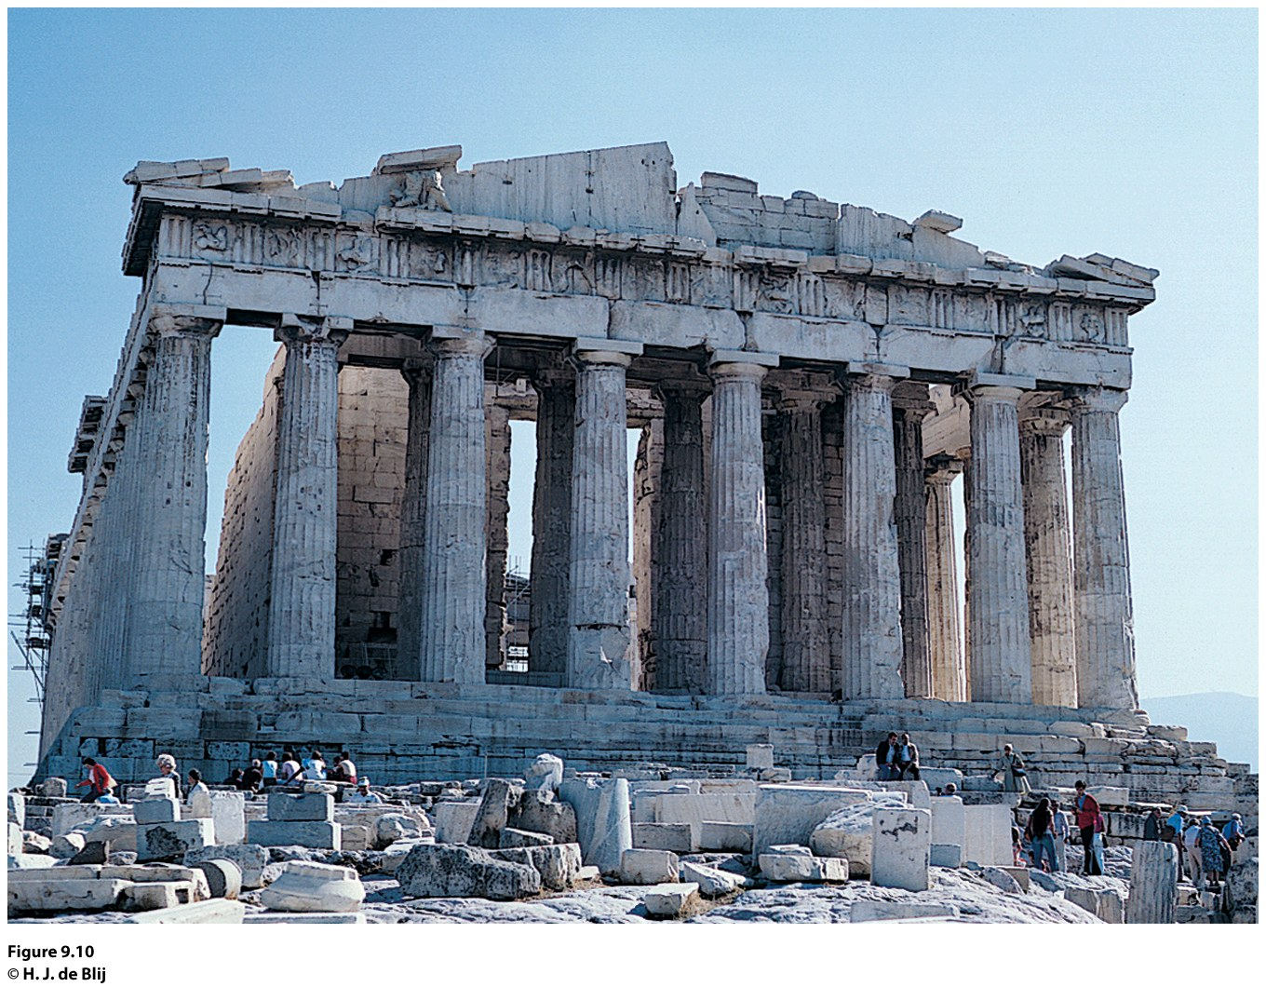
Notes:
Figure 9.10
Athens, Greece. The rocky hilltop of Athens is home to the
Acropolis (acro means high point). The Athens Acropolis is still
crowned by the great Parthenon, standing after nearly 25 centuries.
© H. J. de Blij.

Slide 14
Roman Cities
When the Romans succeeded the Greeks (and Etruscans) as rulers of the region, their empire incorporated not only the Mediterranean shores but also a large part of interior Europe and North Africa.
The site of a city is its absolute location, often chosen for its advantages in trade or defense, or as a center for religious practice.
The situation of a city is based on its role in the larger, surrounding context:
A city’s situation changes with times.
Ex.: Rome becoming the center of the Roman Catholic Church.

Slide 15
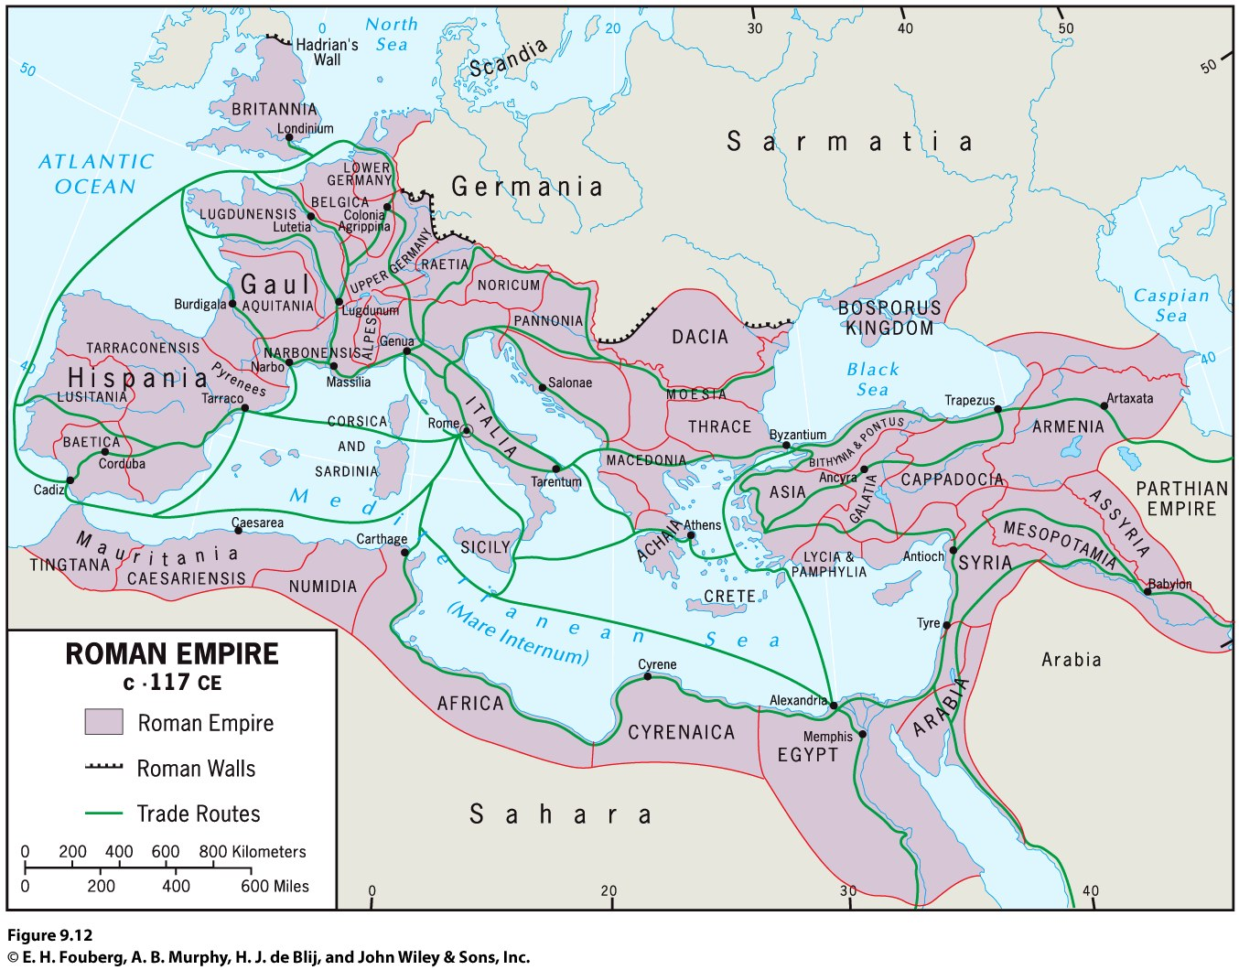

Slide 16
When and Why Did People Start Living in Cities?
Roman Cities
Urban morphology: a city’s layout; its physical form and structure.
Whenever possible, Romans adopted the way the Greeks planned their colonial cities; in a rectangular, grid pattern.
Functional zonation reveals how different areas or segments of a city serve different purposes or functions within the city.
Ex.: the Forum

Slide 17
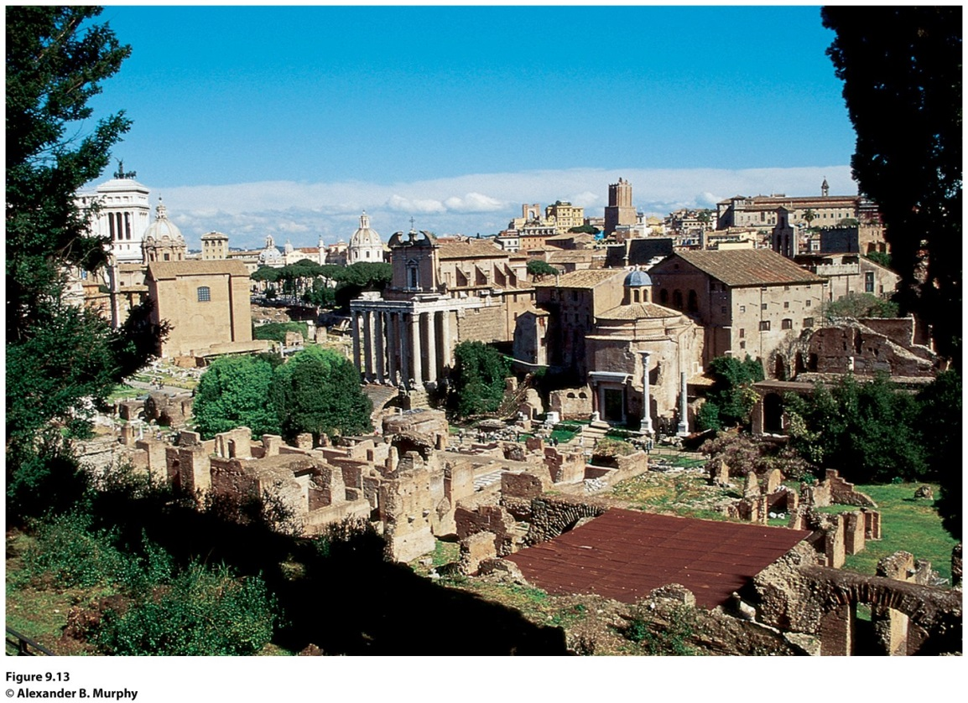
Field Note
“There can be few spaces of greater significance to the development of Western civilization than the Roman Forum. This was the nerve center of a vast empire that transformed the face of western Europe, Southwest Asia, and North Africa. It was also the place where the decisions were made that carried forward Greek ideas about governance, art, urban design, and technology. The very organization of space found in the Roman Forum is still with us: rectilinear street patterns; distinct buildings for legislative, executive, and judicial functions; and public spaces adorned with statues and fountains.”
Notes:
*Could be an audio file.
Figure 9.13
Rome, Italy. © Alexander B. Murphy.

Slide 18
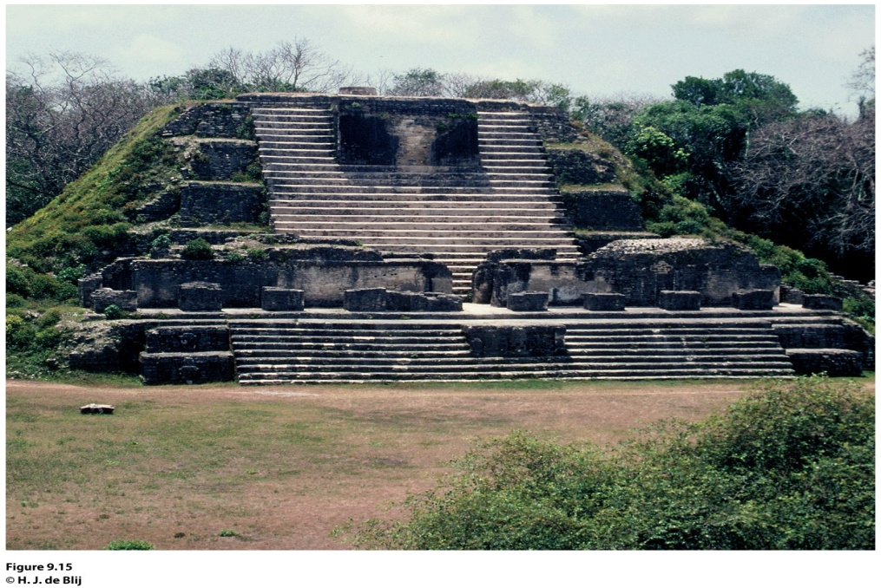
Urban Growth After Greece and Rome
During Europe’s Middle Ages, urbanization continued vigorously outside of Europe.
In West Africa, trading cities developed along the southern margin of the Sahara.
The Americas also experienced significant urban growth, especially within Mayan and Aztec empires.
Notes:
Figure 9.15
ltun Ha, Belize. Between 300 and 900 ce, Altun Ha served as
a thriving trade and distribution center for the Caribbean merchant
canoe traffi c. Some of the trails in Altun Ha led all the way
to Teotihuacan. © H. J. de Blij.

Slide 19
Site and Situation during European Exploration
The relative importance of the interior trade routes changed when European maritime exploration and overseas colonization ushered in an era of oceanic, worldwide trade.
The situation of cities like Paris and Xian changed from being crucial in an interior trading route to being left out of an oceanic trade.
After European exploration took off during the 1400s, the dominance of interior cities declined.

Slide 20
Site and Situation during European Exploration
Coastal cities remained crucial after exploration led to colonialism
The trade networks European powers commanded (including the slave trade) brought unprecedented riches to Europe’s burgeoning medieval cities, such as Amsterdam (the Netherlands), London (England), Lisbon (Portugal), Liverpool (England), and Seville (Spain)
As a result, cities that thrived during mercantilism took on similar properties

Slide 21
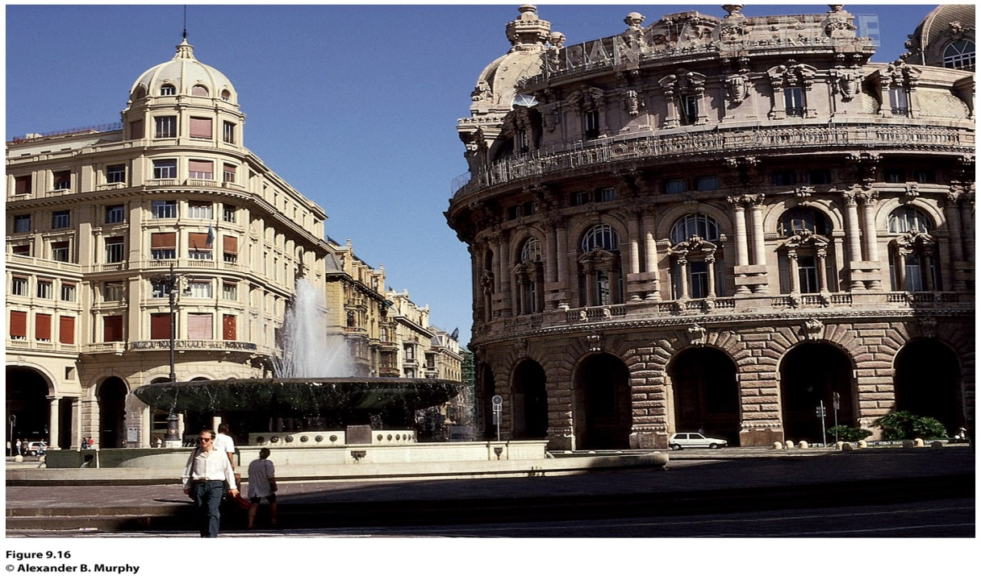
Field Note
“The contemporary landscape of Genoa stands as a reminder of the city’s historic importance. Long before Europe became divided up into states, a number of cities in northern Italy freed themselves from the strictures of feudalism and began to function autonomously. Genoa and Venice were two of these, and they became the foci of significant Mediterranean maritime trading empires. In the process, they also became magnificent, wealthy cities. Although most buildings in Genoa’s urban core date from a more recent era, the layout of streets and public squares harkens back to the city’s imperial days. Is it a surprise that the city gave birth to one of the most famous explorers of all time: Christopher Columbus?”
Notes:
*Could be an audio file.
Figure 9.16
Genoa, Italy. © Alexander B. Murphy.

Slide 22
A Second Urban Revolution
When and Why Did People Start Living in Cities?
Around 1800, Western Europe was still overwhelmingly rural. As thousands migrated to the cities with industrialization, cities had to adapt to the mushrooming population, the proliferation of factories and supply facilities, the expansion of transport systems, and the construction of tenements for the growing labor force.

Slide 23
When and Why Did People Start Living in Cities?
A Second Agricultural Revolution
During the late seventeenth century and into the eighteenth century, Europeans invented a series of important improvements in agriculture.
The second agricultural revolution also improved organization of production, market collaboration, and storage capacities.
Many industrial cities grew from small villages or along canal and river routes.

Slide 24
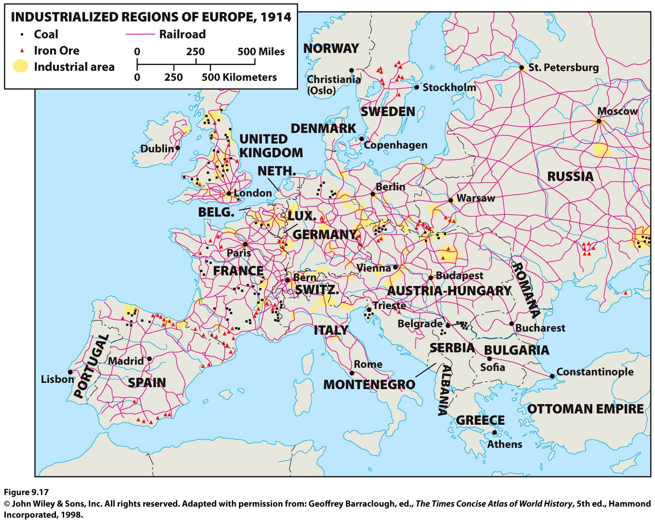
When and Why Did People Start Living in Cities?
When industrialization diffused from Great Britain to the European mainland, the places most ready for industrialization had undergone their own second agricultural revolution, had surplus capital from mercantilism and colonialism, and were located near coal fields.

Slide 25
The Chaotic Industrial City
When and Why Did People Start Living in Cities?
With industrialization, cities became unregulated jumbles of activity.
Living conditions were dreadful for workers in cities, and working conditions were shocking.
The soot-covered cities of the British Midlands were deemed the “black towns.”

Slide 26
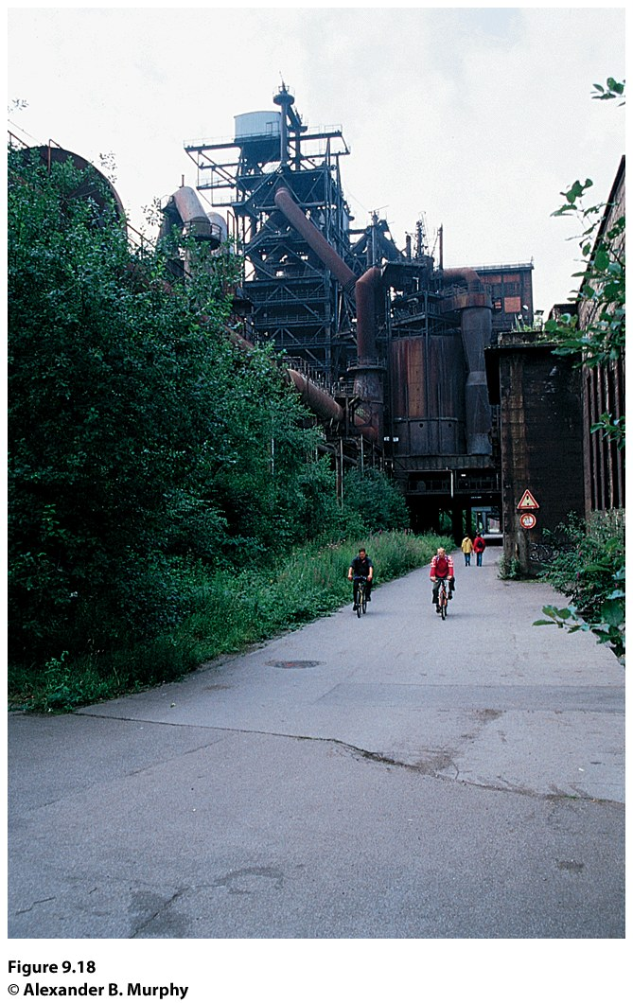
The Chaotic Industrial City
In mid-1800s, as Karl Marx and Frederick Engels encouraged “workers of the world” to unite, conditions in European manufacturing cities gradually improved.
During the second half of the twentieth century, the nature of manufacturing changed, as did its location.
Concept Caching:
Duisburg, Germany

Slide 27
Archaeologists have found that the houses in Indus River cities, such as Mohenjo-Daro and Harappa, were a uniform size: each house had access to a sewer system, and palaces were absent from the cultural landscape. Derive a theory as to why these conditions were present in these cities that had both a leadership class and a surplus of agricultural goods.

Slide 28
Key Question
Where are cities located, and why?

Slide 29
Where Are Cities Located, and Why?
Urban geographers discovered that every city and town has a trade area, an adjacent region within which its influence is dominant.
Three key components arise frequently in urban geography: population, trade area, and distance.
Concept Caching:
Mount Vesuvius

Slide 30
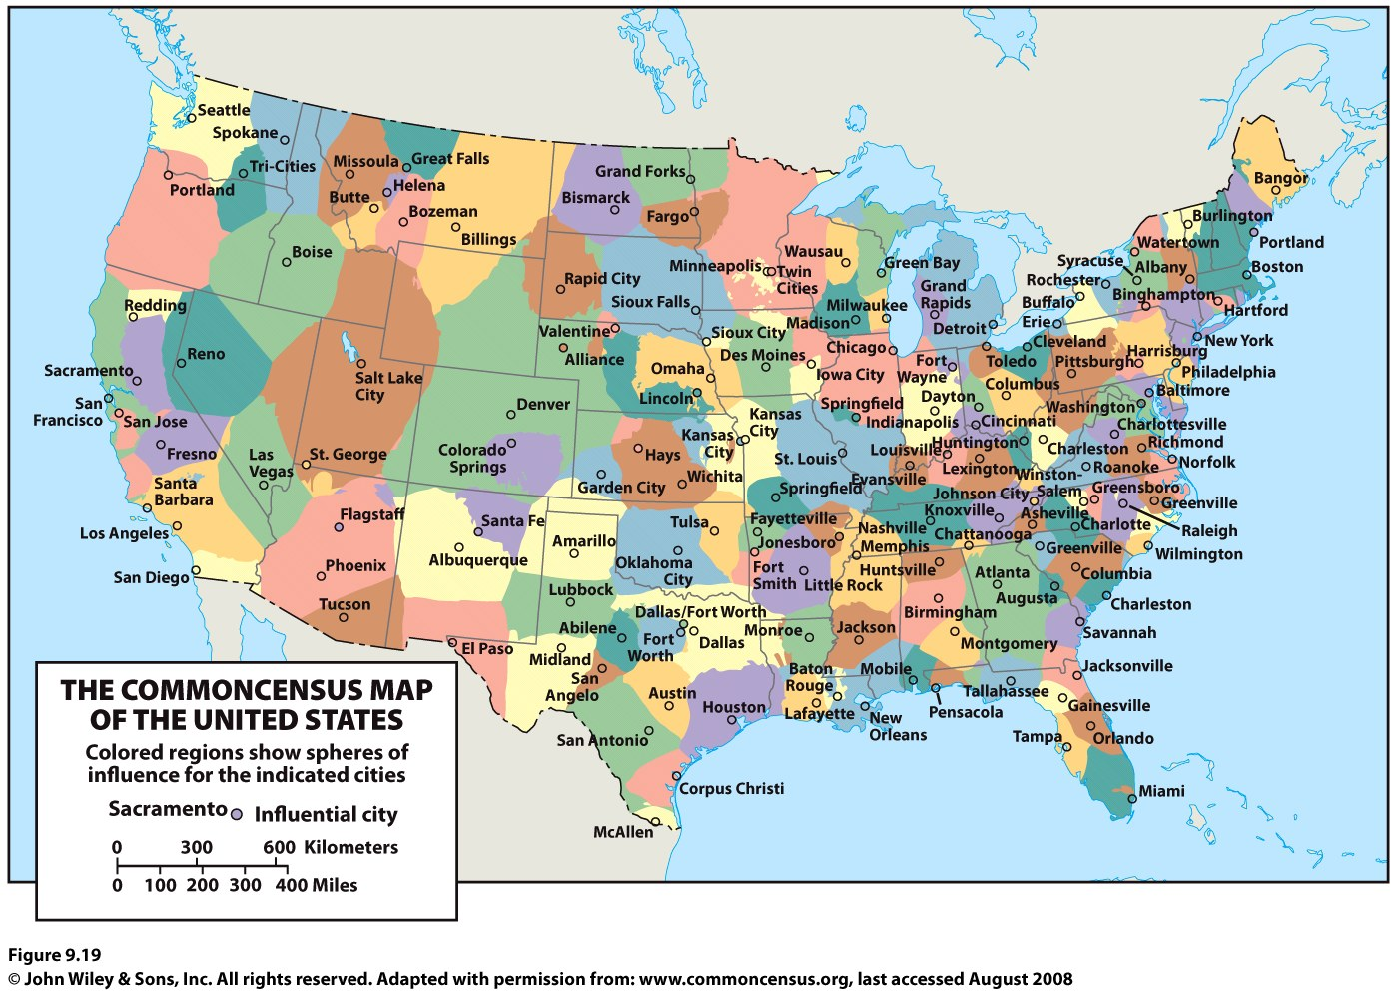

Slide 31
Rank and Size in the Urban Matrix
The rank-size rule holds that in a model urban hierarchy, the population of a city or town will be inversely proportional to its rank in the hierarchy.
German Felix Auerbach, linguist George Zipf.
Random growth (chance) and economies of scale (efficiency) explain why the rank-size rule works where it does.
The rank-size rule does not apply in all countries, especially countries with one dominant city.
Mark Jefferson: A primate city is “a country’s leading city, always disproportionately large and exceptionally expressive of national capacity and feeling.”

Slide 32
Central Place Theory
Central place theory: Walter Christaller, The Central Places in Southern Germany (1933), had five assumptions:
The surface of the ideal region would be flat and have no physical barriers.
Soil fertility would be the same everywhere
Population and purchasing power would be evenly distributed.
The region would have a uniform transportation network to permit direct travel from each settlement to the other.
From any given place, a good or service could be sold in all directions out to a certain distance.

Slide 33
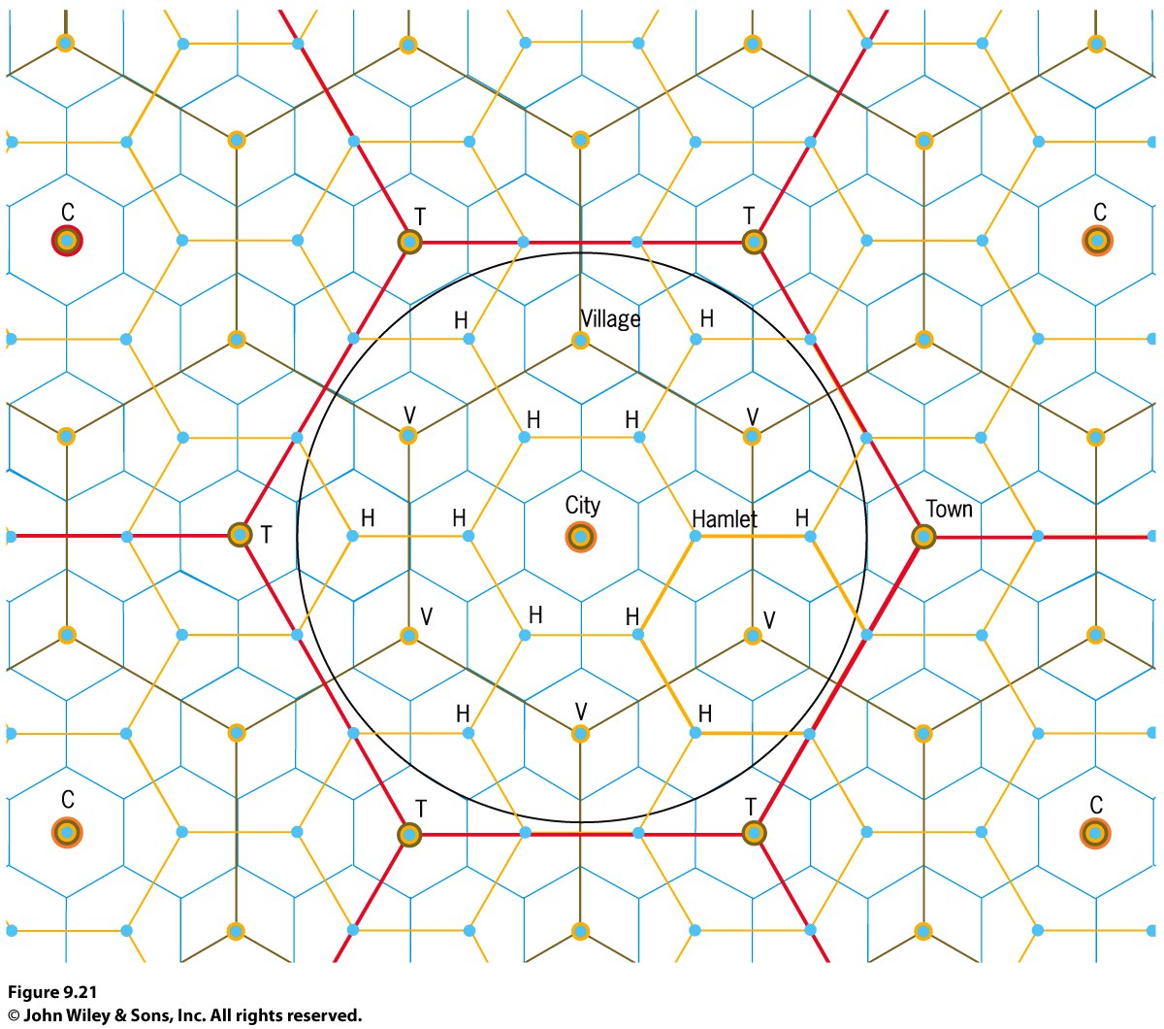
Central Place Theory
Each central place has a surrounding complementary region, an exclusive trade area within which the town has a monopoly on the sale of certain goods.
Hexagonal Hinterlands
Christaller chose perfectly fitted hexagonal regions as the shape of each trade area.

Slide 34
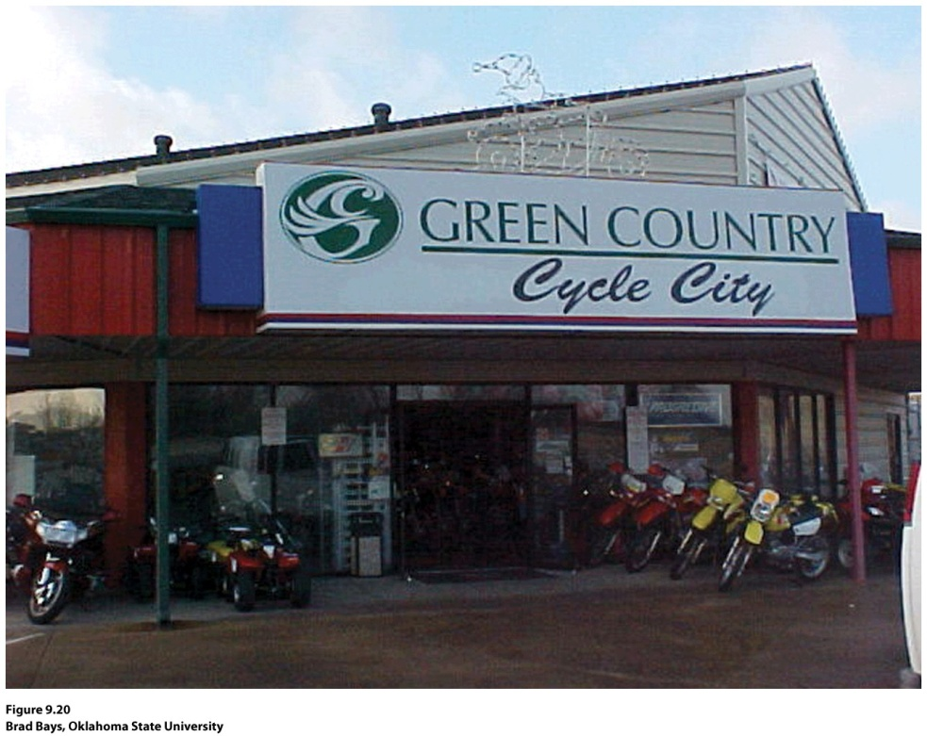
Guest Field Note:
Broken Arrow, Oklahoma
“Many trade areas in the United States are named, and their names typically coincide with the vernacular region, the region people perceive themselves as living in. In promoting a trade area, companies often adopt, name, or shape the name of the vernacular region. In Oklahoma, the label Green Country refers to the northeastern quarter of the state, the trade area served by Tulsa.”
Credit: Brad Bays, Oklahoma State University
Notes:
Figure 9.20
Credit: Brad Bays, Oklahoma State University

Slide 35
Central Places Today
Where Are Cities Located, and Why?
New factors, forces, and conditions not anticipated by Christaller’s models and theories make them less relevant today.
Ex.: The Sun Belt phenomenon: the movement of millions of Americans from northern and northeastern states to the South and Southwest.

Slide 36
Key Question
How are cities organized, and how do they function?

Slide 37
How Are Cities Organized, and How Do They Function?
Models of the City
Functional zonation: the division of the city into certain regions (zones) for certain purposes (functions).
Globalization has created common cultural landscapes in the financial districts of many world cities.
Regional models of cities help us understand the processes that forged cities in the first place and understand the impact of modern linkages and influences now changing cities.

Slide 38
Functional Zones
Zone is typically preceded by a descriptor that conveys the purpose of that area of the city.
Most models define the key economic zone of the city as the central business district (CBD).
Central city describes the urban area that is not suburban. In effect, central city refers to the older city as opposed to the newer suburbs.
A suburb is an outlying, functionally uniform part of an urban area, and is often (but not always) adjacent to the central city.
Suburbanization is the process by which lands that were previously outside of the urban environment become urbanized, as people and businesses from the city move to these spaces.

Slide 39
Functional Zones
P.O. Muller: Contemporary Suburban America (1981):
Found suburban cities ready to compete with the central city for leading urban economic activities.
In addition to expanding residential zones, the process of suburbanization rapidly creates distinct urban regions complete with industrial, commercial, and educational components.

Slide 40
Modeling the North American City
Concentric zone model: resulted from sociologist Ernest Burgess’s study of Chicago in the 1920s. Burgess’s model divides the city into five concentric zones, defined by their function:
CBD is itself subdivided into several subdistricts.
Zone of transition is characterized by residential deterioration and encroachment by business and light manufacturing.
Zone 3 is a ring of closely spaced but adequate homes occupied by the blue-collar labor force.
Zone 4 consists of middle-class residences.
Zone 5 is the suburban ring.

Slide 41
Modeling the North American City
Homer Hoyt: Sector model
The city grows outward from the center, so a low-rent area could extend all the way from the CBD to the city’s outer edge, creating zones that are shaped like a piece of pie.
The pie-shaped pieces describe the high-rent residential, intermediate rent residential, low-rent residential, education and recreation, transportation, and industrial sectors.

Slide 42
Modeling the North American City
Chauncy Harris and Edward Ullman: multiple nuclei model
This model recognizes that the CBD was losing its dominant position as the single nucleus of the urban area.
Edge cities: Suburban downtowns developed mainly around big regional shopping centers; they attracted industrial parks, office complexes, hotels, restaurants, enter-tainment facilities, and sports stadiums.

Slide 43
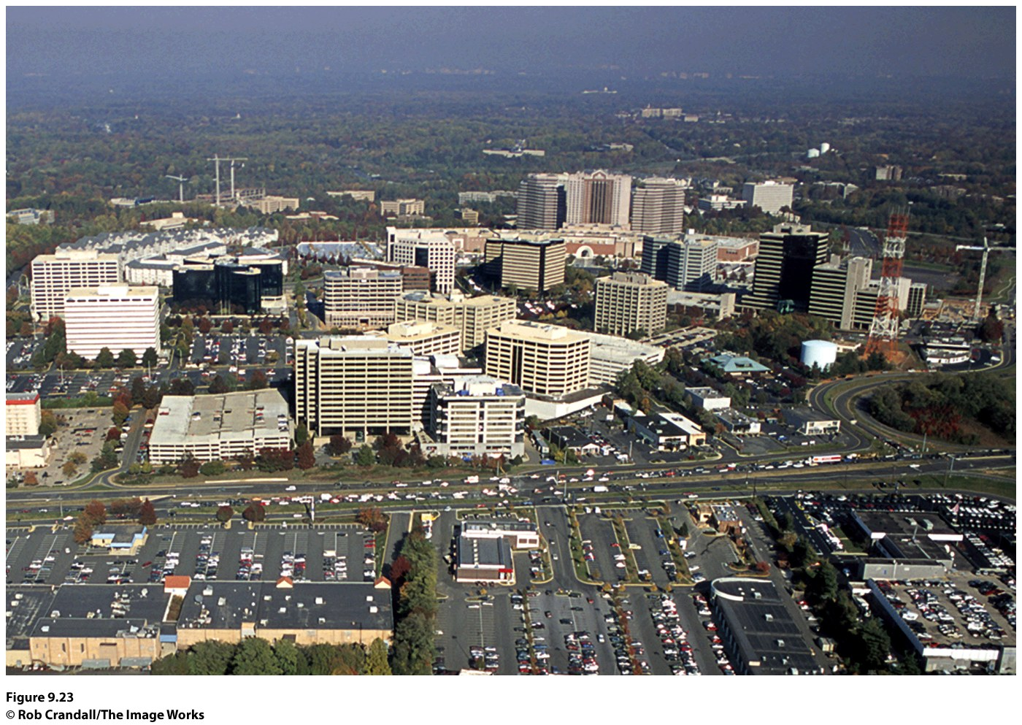
Figure 9.23
Tysons Corner, Virginia. In the suburbs of Washington, D.C., on Interstate 495 (the Beltway), Tysons Corner has developed as a major edge city, with offices, retail, and commercial services. © Rob Crandall/The Image Works.
Notes:
Figure 9.23
Tysons Corner, Virginia. In the suburbs of Washington, D.C., on Interstate 495 (the Beltway),
Tysons Corner has developed as a major edge city, with offi ces, retail, and commercial services. © Rob
Crandall/The Image Works.

Slide 44
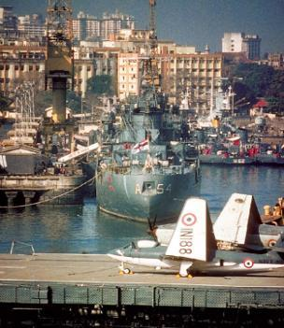
Modeling the Cities of the Global Periphery and Semiperiphery
Primate cities in developing countries are called megacities when the city has a large population, a vast territorial extent, rapid in-migration, and a strained, inadequate infrastructure.
Concept Caching:
Mumbai, India
© Harm de Blij

Slide 45
The South American City
Griffin-Ford model
South American cities blend traditional elements of South American culture with globalization forces that are reshaping the urban scene, combining radial sectors and concentric zones.
The thriving CBD anchors the model.
Shantytowns are unplanned groups of crude dwellings and shelters made of scrap wood, iron, and pieces of cardboard that develop around cities.

Slide 46
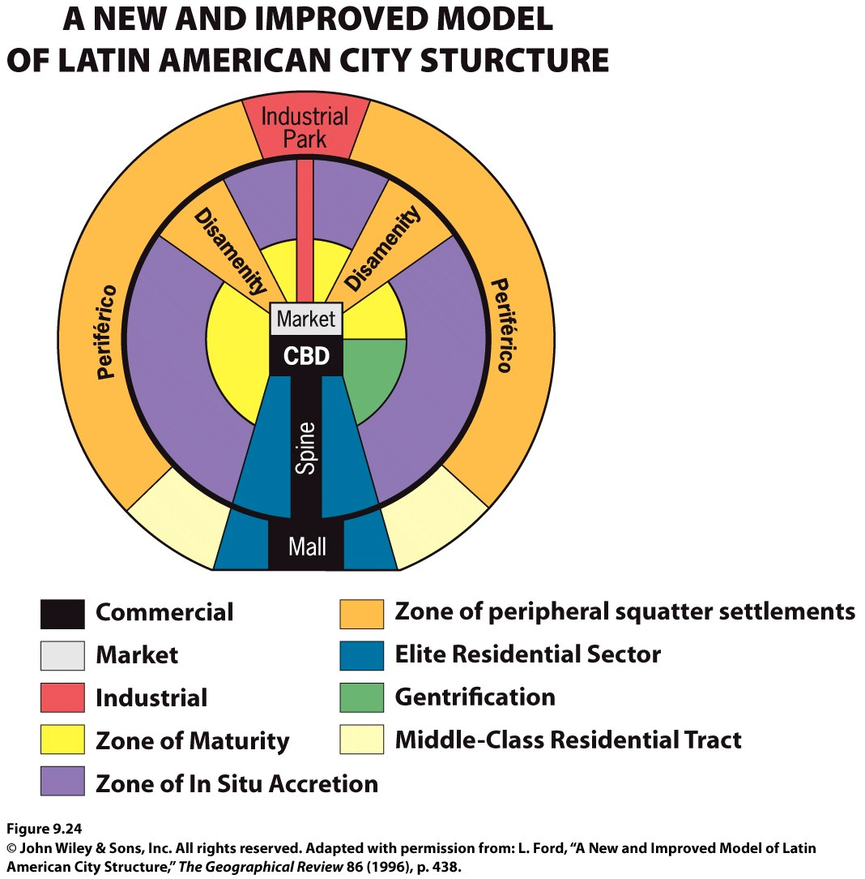

Slide 47
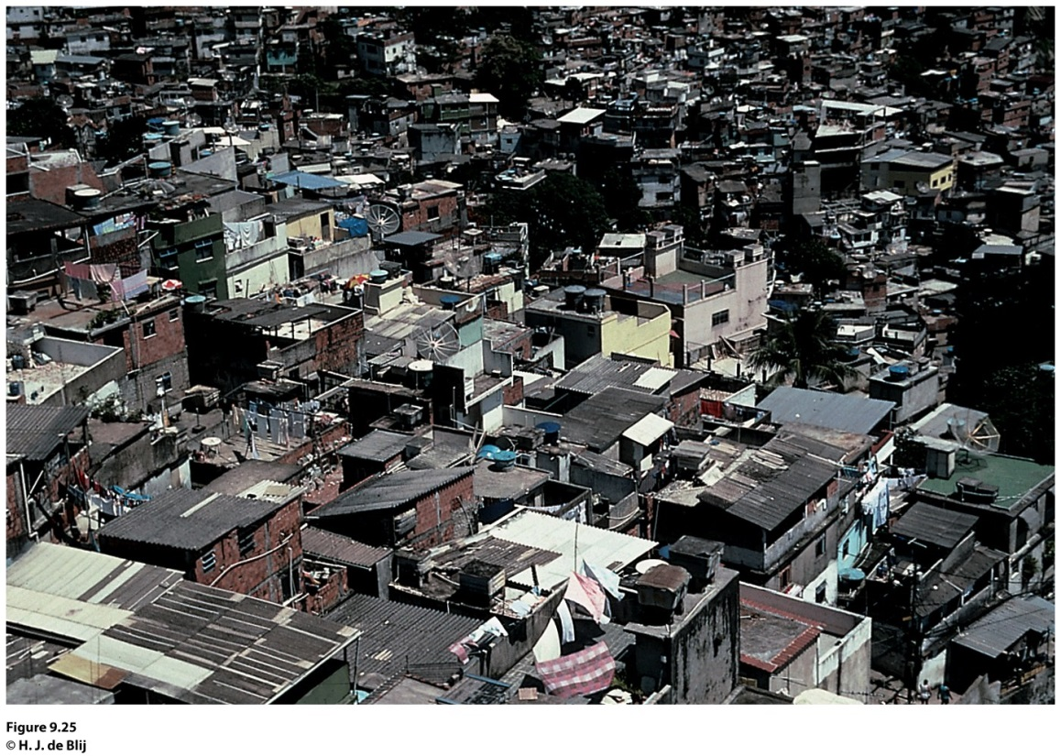
Field Note
“February 1, 2003. A long-held hope came true today: thanks to a Brazilian intermediary I was allowed to enter and spend a day in two of Rio de Janeiro’s hillslope favelas, an eight-hour walk through one into the other. Here live millions of the city’s poor, in areas often ruled by drug lords and their gangs, with minimal or no public services, amid squalor and stench, in discomfort and danger.
Notes:
*Could also be an audio file.
Figure 9.25
Rio de Janeiro, Brazil. © H. J. de Blij.

Slide 48
The African City
The imprint of European colonialism can still be seen in many African cities.
During colonialism, Europeans laid out prominent urban centers.
The centers of South Africa’s major cities (Johannesburg, Cape Town, and Durban) remain essentially Western.
Studies of African cities indicate that the central city often consists of not one but three CBDs: a remnant of the colonial CBD, an informal and sometimes periodic market zone, and a transitional business center where commerce is conducted.

Slide 49
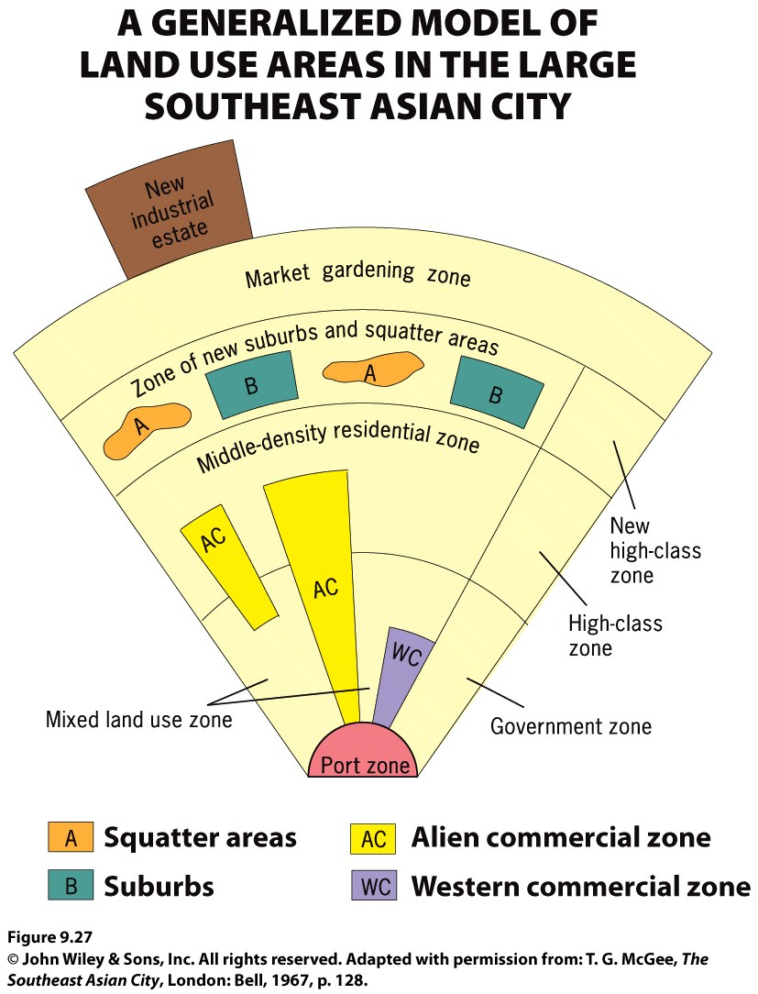
The Southeast Asian City
Figure 9.27
Model of the Large Southeast Asian City. A model of land use in the medium-sized Southeast Asian city includes sectors and zones within each sector. Adapted with permission from: T. G. McGee, The Southeast Asian City, London: Bell, 1967, p. 128.
Notes:
Figure 6.19
Llanfairpwllgwyngyllgogerychwyrndrobwllllantysiliogogogoch, Wales. The town with
the self-proclaimed longest name in the world attracts hordes of tourists each year to a place
whose claim to fame is largely its name. © Alexander B. Murphy.

Slide 50
Key Question
How do people share cities?

Slide 51
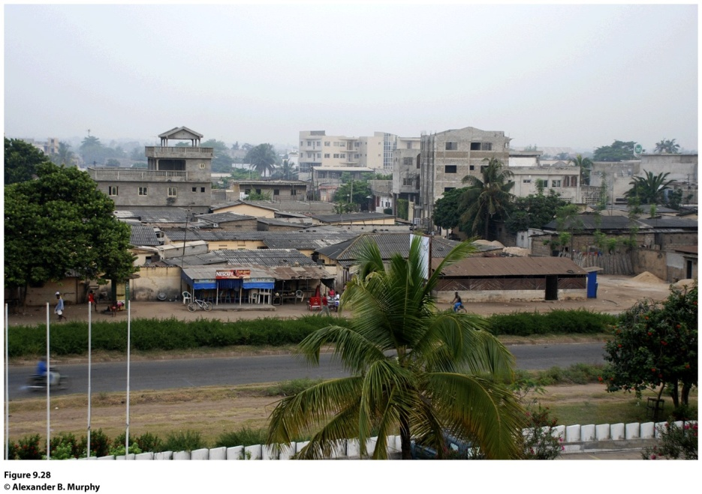
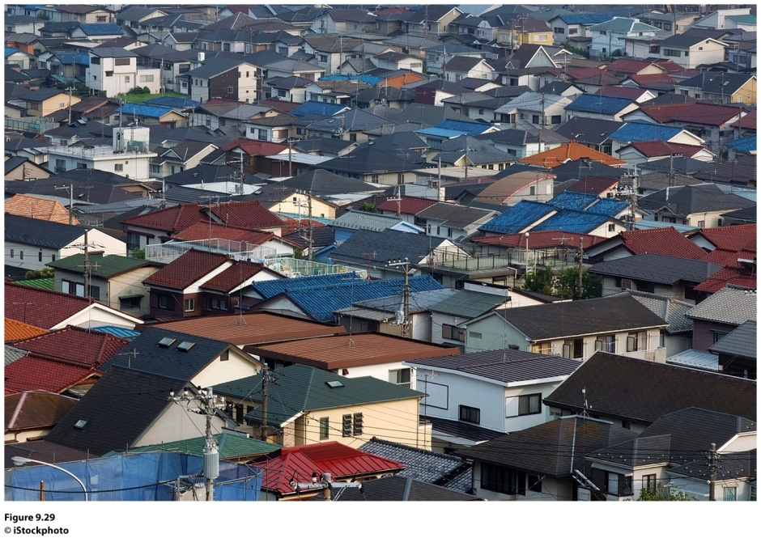
How Do People Share Cities?
Zoning laws: Cities define areas of the city and designate the kinds of development allowed in each zone.
Figure 9.28
Lomé, Togo. The city’s landscape reflects a clear dichotomy between the “haves” and “have-nots.”
© Alexander B. Murphy.
Figure 9.29
Tokyo, Japan. The city’s landscape reflects the presence of a large middle class in a densely populated
city. © iStockphoto.

Slide 52
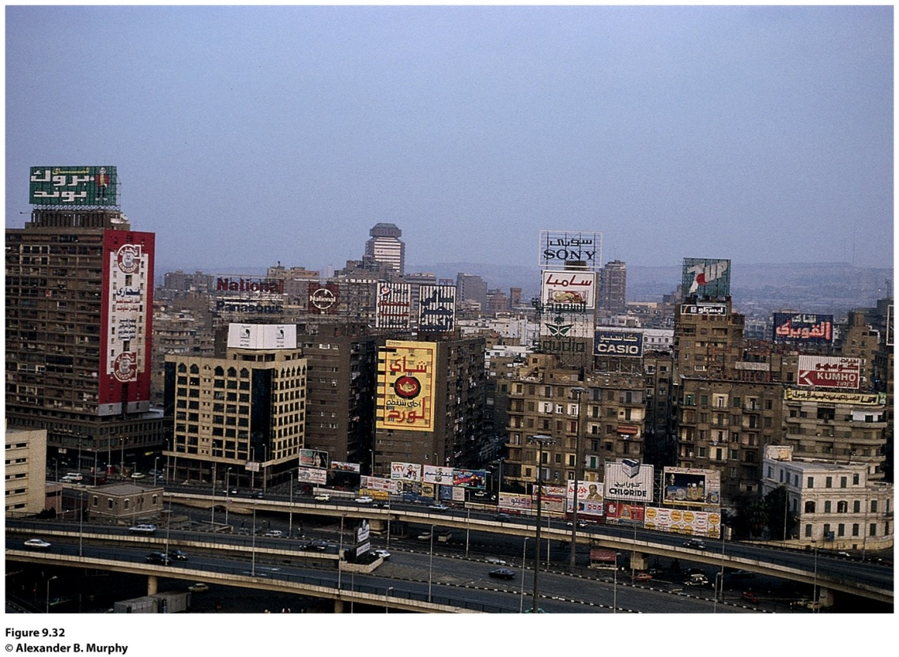
Field Note
“Central Cairo is full of the multistory buildings, transportation arteries, and commercial signs that characterize most contemporary big cities. Outside of a number of mosques, few remnants of the old medieval city remain. The first blow came in the nineteenth century, when a French educated ruler was determined to recast Cairo as a world-class city. Inspired by the planning ideas of Paris’s Baron von Hausman, he transformed the urban core into a zone of broad, straight streets. In more recent years the forces of modern international capitalism have had the upper hand. There is little sense of an overall vision for central Cairo. Instead, it seems to be a hodge-podge of buildings and streets devoted to commerce, administration, and a variety of producer and consumer services.”
Notes:
*Could be an audio file.
Figure 9.32
Cairo, Egypt. © Alexander B. Murphy

Slide 53
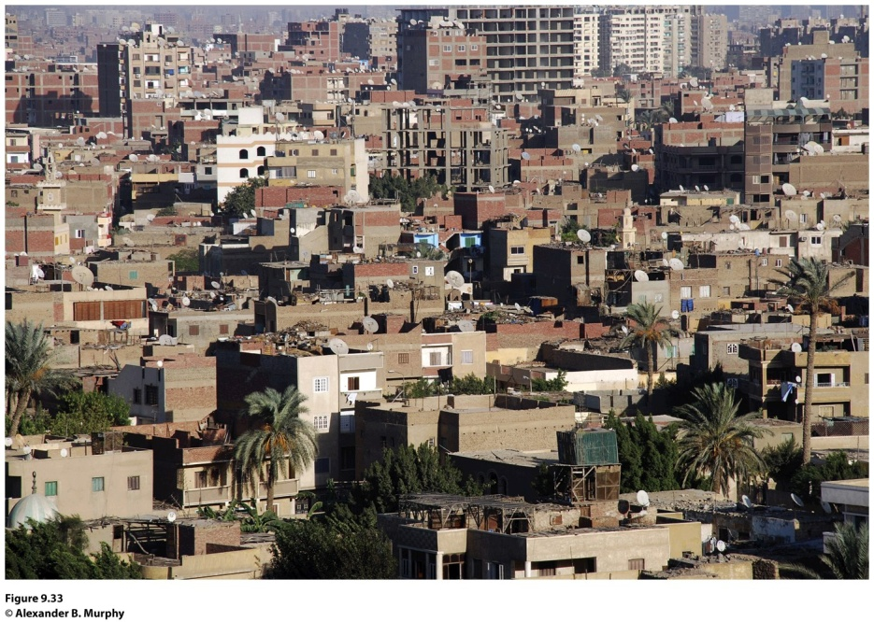
Field Note
“Moving out from central Cairo, evidence of the city’s rapid growth is all around you. These hastily built housing units are part of the (often losing) effort to keep up with the city’s exploding growth. From a city of just one million people in 1930, Cairo’s population expanded to six million by 1986. And then high growth rates really kicked in. Although no one knows the exact size of the contemporary city, most estimates suggest that Cairo’s population has doubled in the last 20 years. This growth has placed a tremendous strain on city services. Housing has been a particularly critical problem—leading to a landscape outside the urban core dominated by hastily built, minimally functional, and aesthetically non-descript housing projects.”
Notes:
*Could be an audio file.
Figure 9.33
Cairo, Egypt. © Alexander B. Murphy.

Slide 54
Shaping Cities in the Global Periphery and Semiperiphery
How Do People Share Cities?
Particularly in the economic periphery, new arrivals (and long-term residents) crowd together in overpopulated apartments, dismal tenements, and teeming slums.
Cities in poorer parts of the world generally lack enforceable zoning laws.
Across the global periphery, the one trait all major cities display is the stark contrast between the wealthy and poor.

Slide 55
Shaping Cities in the Global Core
How Do People Share Cities?
During the segregation era in the United States, Realtors, financial lenders, and city governments defined and segregated spaces in urban environments.
Ex.: redlining, blockbusting
White flight—movement of whites from the city and adjacent neighborhoods to the outlying suburbs.

Slide 56
How Do People Share Cities?
In order to counter the suburbanization trend, city governments are encouraging commercialization of the central business district and gentrification of neighborhoods in and around the central business district.
Commercialization entails transforming the central business district into an area attractive to residents and tourists alike.
Gentrification is the rehabilitation of houses in older neighborhoods.
Teardowns: suburban homes meant for demolition; the intention is to replace them with McMansions.

Slide 57
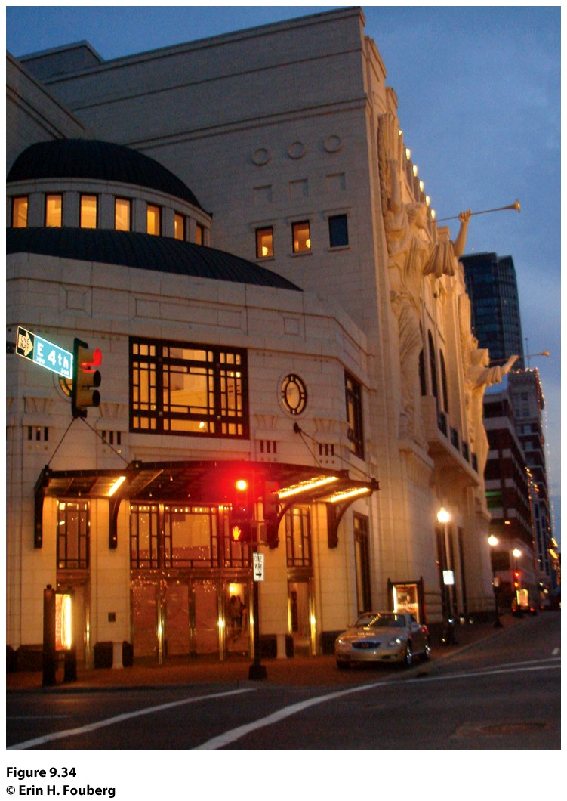
Field Note
“In 2008, downtown Fort Worth, Texas looked quite different than it did when I first visited in 1997. In that eleven year period, business leaders in the City of Fort Worth gentrified the downtown. The Bass family, who has a great deal of wealth from oil holdings and who now owns about 40 blocks of downtown Fort Worth, was instrumental in the city’s gentrification. In the 1970s and 1980s, members of the Bass family looked at the empty, stark, downtown Fort Worth, and sought a way to revitalize the downtown. They worked with the Tandy family to build and revitalize the spaces of the city, which took off in the late 1990s and into the present century. The crown jewel in the gentrified Fort Worth is the beautiful cultural center called the Bass Performance Hall, named for Nancy Lee and Perry R. Bass, which opened in 1998.”
Concept Caching:
Forth Worth, Texas
Notes:
*Could be an audio file.
Figure 9.34
Fort Worth, Texas. © Erin H. Fouberg.

Slide 58
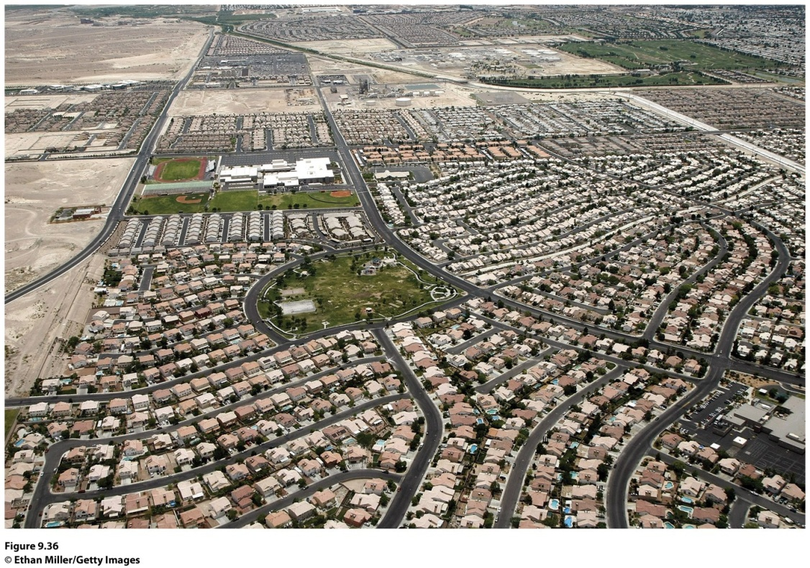
Urban Sprawl and New Urbanism
How Do People Share Cities?
Urban sprawl: unrestricted growth of housing, commercial developments, and roads over large expanses of land, with little concern for urban planning
Notes:
Figure 9.36
Henderson, Nevada. Henderson is the
largest suburb of Las Vegas, and it was also
the fastest-growing urban settlement in the
United States between 1990 and 2000. Many
of the houses in this photograph are empty
today, as Las Vegas has been fi rst or second
in the number of home and rental vacancies
in United States cities in 2009 and 2010.

Slide 59
Urban Sprawl and New Urbanism
To counter urban sprawl, a group of architects, urban planners, and developer outlined an urban design vision they call new urbanism: development, urban revitalization, and suburban reforms that create walkable neighborhoods with a diversity of housing and jobs
Geographer David Harvey argues the new urbanism movement is a kind of “spatial determinism” that does not recognize that “the fundamental difficulty with modernism was its persistent habit of privileging spatial forms over social processes.”
Other critics say “communities” that new urbanists form through their projects are exclusionary and deepen the racial segregation of cities.

Slide 60
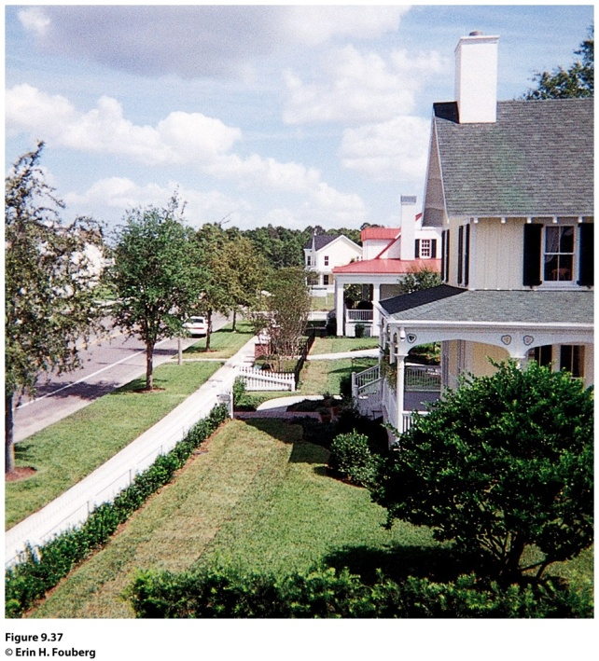
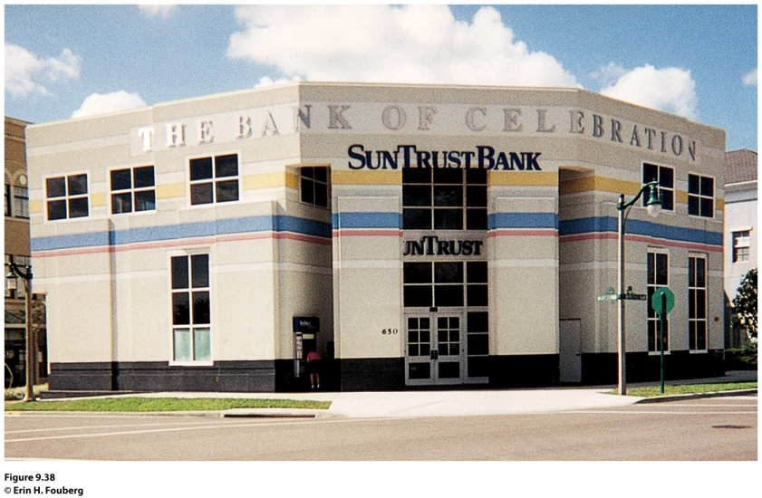
Field Note
“When I visited Celebration, Florida, in 1997, I felt like I was walking onto a movie or television set. The architecture in the Walt Disney designed new urbanist development looked like the quintessential New England town. Each house has a porch, but on the day I was there, the porches sat empty—waiting to welcome the arrival of their owners at the end of the work day. We walked through town, past the 50s-style movie marquee, and ate lunch at a 50s-style diner. At that point, Celebration was still growing. Across the street from the Bank of Celebration’ stood a sign marking the future home of the ‘Church in Celebration.’”
Notes:
*Could be an audio file.
Figure 9.37 and 9.38
Celebration, Florida. © Erin H. Fouberg

Slide 61
Gated Communities
How Do People Share Cities?
Fenced-in neighborhoods with controlled access gates for people and automobiles.
Main objective is to create a space of safety within the uncertain urban world.
Secondary objective is to maintain or increase housing values in the neighborhood through enforcement of the neighborhood association’s bylaws.
Many fear that the gated communities are a new form of segregation.

Slide 62
Ethnic Neighborhoods in the European City
How Do People Share Cities?
Ethnic neighborhoods in European cities are typically affiliated with migrants from former colonies.
Migration to Europe is constrained by government policies and laws.
European cities are typically more compact, densely populated, and walkable than American cities.
Housing in the European city is often combined with places of work.

Slide 63
Government Policy and Immigrant Accommodation
How Do People Share Cities?
Whether a public housing zone is divided into ethnic neighborhoods in a European city depends in large part on government policy.
Brussels, Belgium: has very little public housing; immigrants live in privately owned rentals throughout the city.
Amsterdam, the Netherlands: has a great deal of public housing and few ethnic neighborhoods within the public housing units.

Slide 64
Ethnic Neighborhoods in the Global Periphery and Semiperiphery City
In cities of the periphery and semiperiphery, a sea of slum development typically begins where the permanent buildings end, in some cases engulfing and dwarfing the central city.
Millions of migrants travel to such environments every year.
City governments do not have the resources to adequately educate, medicate, or police the burgeoning populations.
The vast slums of cities in poorer parts of the world are typically ethnically delineated, with new arrivals precariously accommodated.

Slide 65
How Do People Share Cities?
Power and Ethnicity
The settlement patterns of cities developed during the colonial period often persist long after
The Informal Economy
The economy that is not taxed and is not counted toward a country’s gross national income
Remittances

Slide 66
From Colonial to Global CBD
How Do People Share Cities?
Geographers Richard Grant and Jan Nijman documented globalization in former colonial port cities, including Mumbai, India.
A new spatially demarcated foreign presence has arisen.
The city now has a global CBD at the heart of the original colonial city, housing mostly foreign corporations and multinational companies and linked mainly to the global economy.

Slide 67
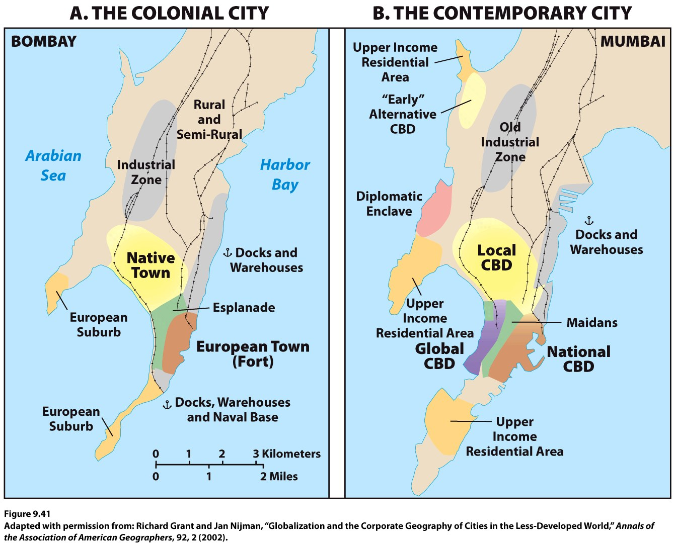
Notes:
Figure 9.41
The Changing Character of Mumbai, India. Adapted with permission from: Richard Grant and Jan Nijman,
“Globalization and the Corporate Geography of Cities in the Less-Developed World,” Annals of the Association of American
Geographers, 92, 2 (2002).

Slide 68
Key Question
What role do cities play in globalization?

Slide 69
What Role Do Cities Play in Globalization?
World cities function at the global scale, beyond the reach of the state borders, functioning as the service centers of the world economy.
Felsenstein, Schamp, and Shachar: The world city is a node in globalization, reflecting processes that have “redrawn the limits on spatial interaction.”
World cities do not exist merely to service players in the global economy.
Some countries such as the United States and Germany have two or more world cities within their state borders.

Slide 70
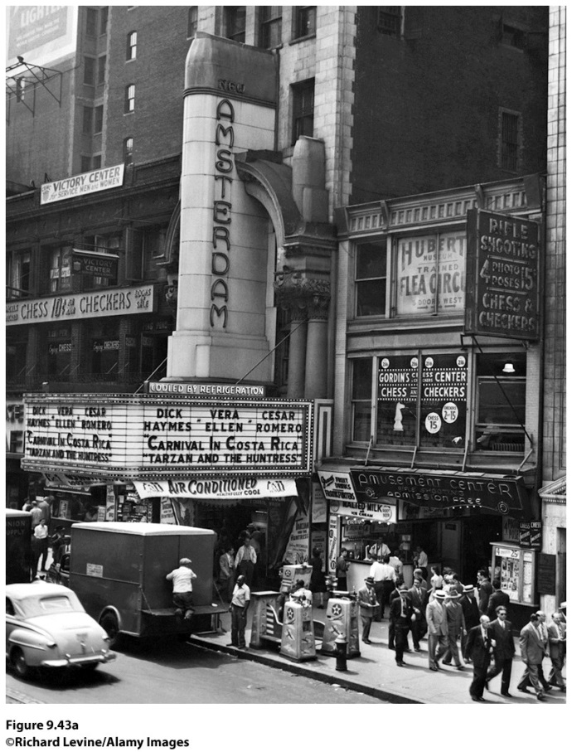
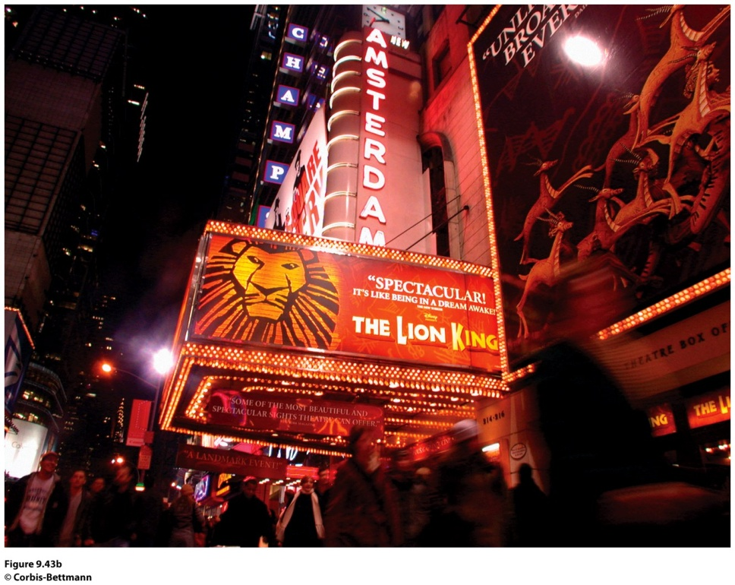
Cities as Spaces of Consumption
Media corporations are helping transform urban centers into major entertainment districts where items are consumed
Notes:
Figure 9.43, left and right
New York, New York. (left) The New Amsterdam Theater in Times Square as it stood in
1947. Note the signs around the building, advertising arcade games and a fl ea circus. (right)
During the 1980s and 1990s, Times Square was “cleaned up” and reinvigorated. The Walt Disney
Company renovated the New Amsterdam Theater and now shows productions of musicals such
as Beauty and the Beast and The Lion King. (left): ©Richard Levine/Alamy Images, (right): © Corbis-Bettmann.
Disney set the new course for a family-friendly entertainment
district in New York. The restored New Amsterdam
Theater hosts Di s ney musicals such as The Lion King and
Beauty and the Beast (both based on Disney movies). The
Times Square area is assuredly a space of consumption and a
variation on a theme park: themed restaurants (Hard Rock
Café, ESPN Zone), cross-promoting themed stores (Warner
Brothers Store, Disney Store), and retail stores that cater to
families (an enormous Toys R Us with a ferris wheel inside).
In 2009, New York Mayor Michael Bloomberg
closed portions of Broadway in Times Square to traffi
c and created an urban esplanade with lawn chairs and
seating to advance his goal of making the city more livable.
New Yorkers and tourists took to the new seating
and moved in with laptops in hand. Times Square and the
Hi-Line Walkway in New York now have bleacher-style
seating as well as chairs to encourage New Yorkers to sit a
spell and enjoy the city.
Potsdamer Platz in Berlin is also becoming a new
space of

Slide 71
Thinking through the challenges to the state presented in Chapter 8, predict whether and under what circumstances world cities could replace states as the basic and most powerful form of political organization in the world.

Slide 72
Additional Resources
Celebration, Florida
http://www.celebration.fl .us
Congress for the New Urbanism
http://www.cnu.org
Globalization and World Cities
http://www.lut.ac.uk/gawc/index.html
Opposition to Urban Sprawl
http://www.sierraclub.org/sprawl
Seaside, Florida
http://www.seasidefl .com

